Slide 1
Near Space Exploration
Arko

Slide 2
About Me
Undergrad at Cal Poly Pomona
Electrical Engineering – emphasis in control systems
Work for JPL/NASA
Software engineer for electronic part reliability testing/reporting systems
Previous projects and work
Omni-directional drive system robots
Self-balancing robots
Harsh environment sensors
Plasma Lighting RF Ballasts
Many self-funded projects
DISCLAMER
I am NOT here to represent JPL/NASA, all opinions and information provided are my own and are public information.

Slide 3
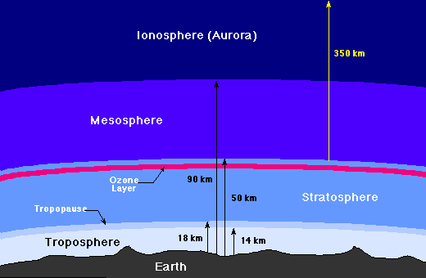
What is Near Space?
Space
330,000ft-ish
Near Space
100,000ft-ish
University of Tennessee, Knoxville
http://csep10.phys.utk.edu/astr161/lect/earth/atmosphere.gif

Slide 4
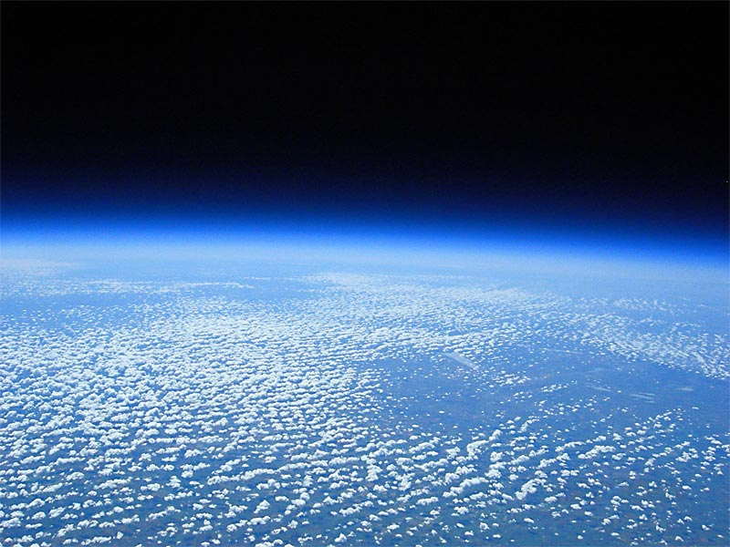
Near Space

Slide 5
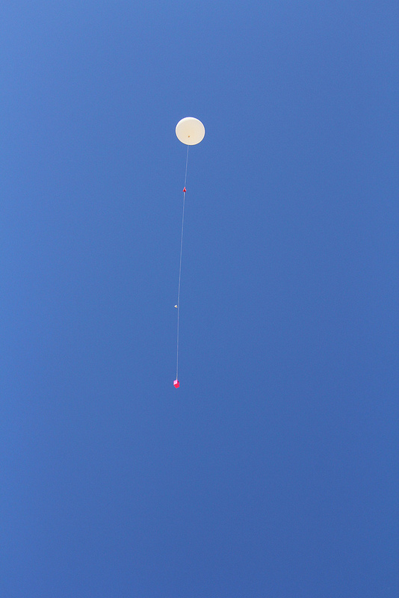
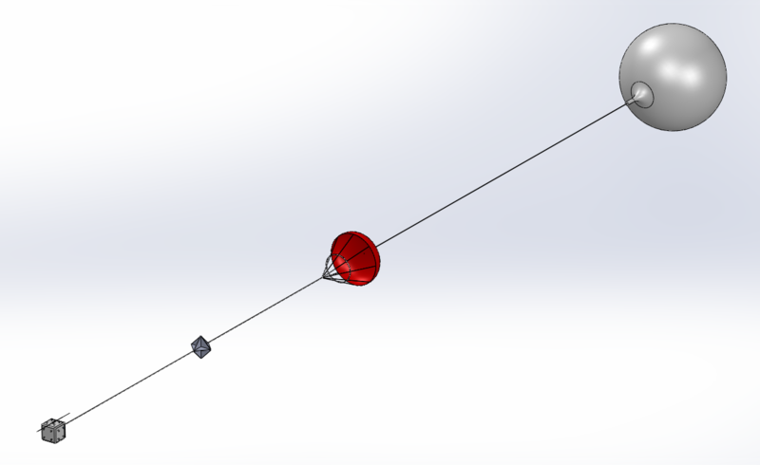
What is a HAB?
Payload
(Radio inside)
Parachute
Balloon
Notes:
- What is it (Balloon+light gas+Parachute+Payload with radios)
- Why? (Camera, Science, Radio Testing, ENV, Rocket Testing, Weather, etc)

Slide 6
What is a HAB?
~100,000ft
0ft
Notes:
- What is it (Balloon+light gas+Parachute+Payload with radios)
- Why? (Camera, Science, Radio Testing, ENV, Rocket Testing, Weather, etc)

Slide 7
Flight Path
Notes:
- Example path
- Example prediction and why it's important to follow ascent/descent rates
- Example landing zone / recovery

Slide 8
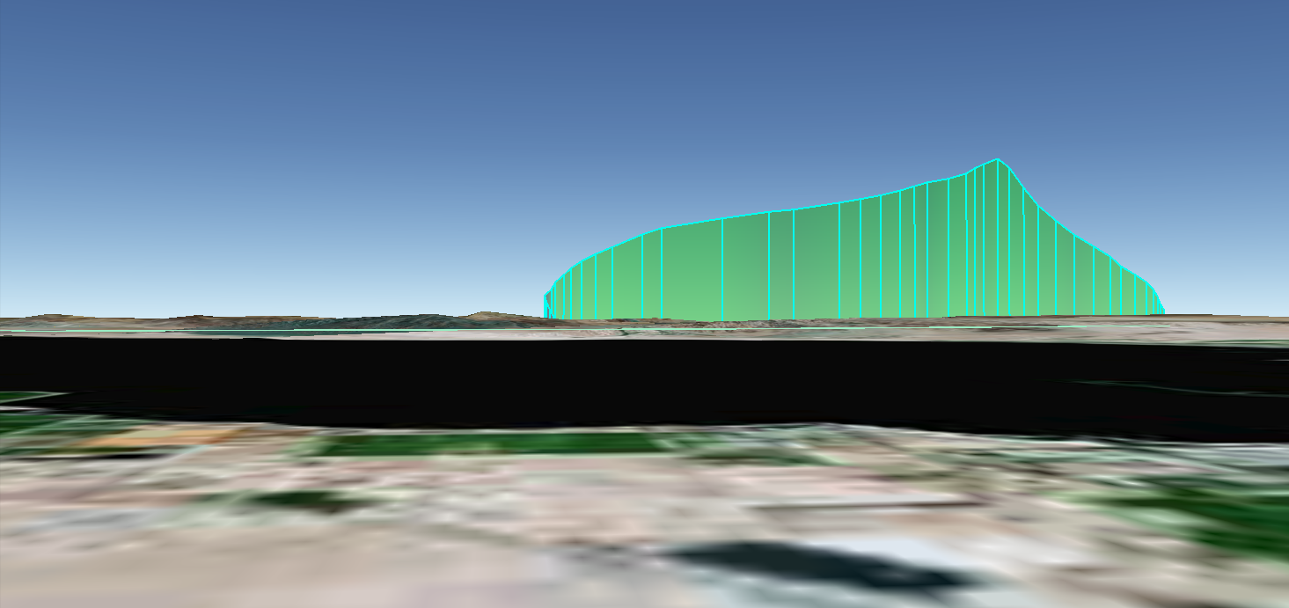
View from the ground

Slide 9
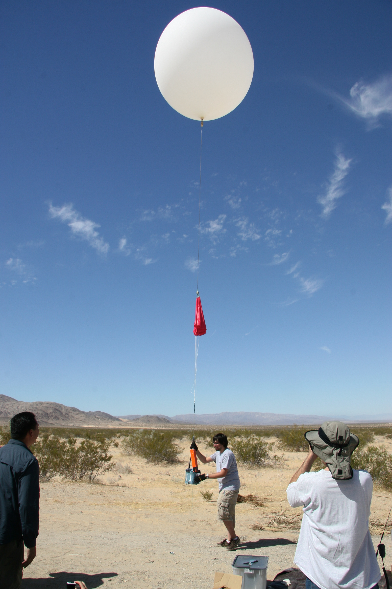
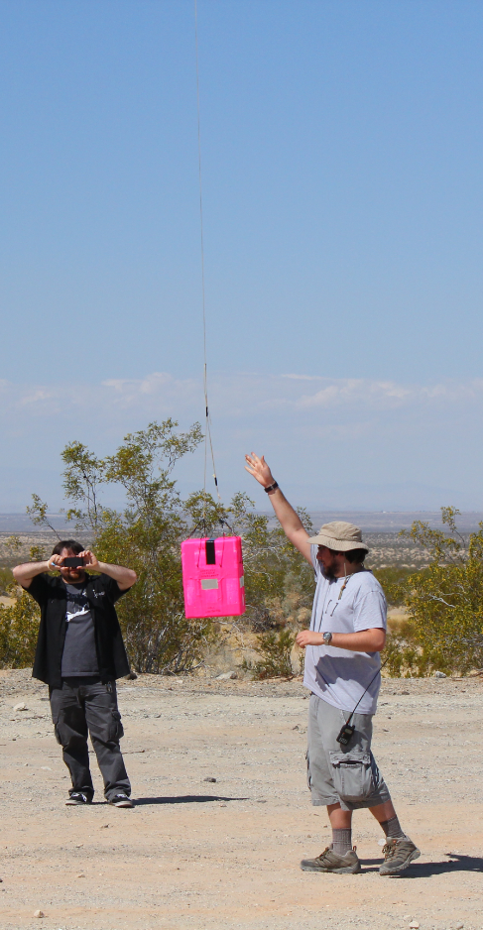
History
HABEX1 HABEX2 HABEXpico (Launching in 1 hour!!)
Notes:
- I will reference them throughout the talk then go into detail at the end

Slide 10
Goals
What do you want your HAB to do?
Launch/Track/Recover (radio test, teh lulz)
Take pretty pictures
Weather data
Send stuff up to take pictures with
Solar eclipse
RF hackery

Slide 11
Friends and Money
Get people to help
looking over your design
helping tracking
Contributing parts, budgeting them space/mass to fly stuff
Setup a budget
Low Cost: $100 – 300
Simple tracker
Small camera
Medium Cost: $600 – $800
Nicer radios & camera
Science
I’m Rich: $800 < monay
Nicer Radios
Expensive Science & etc

Slide 12
Launch locations
Launch Location:
Away from powerlines
Away from public interference
Large flat area
Landing Location (what actually determines the launch location):
Away from large bodies of water
Away from large mountains
Away from military and busy airspace
Use high altitude balloon flight path predictor

Slide 13
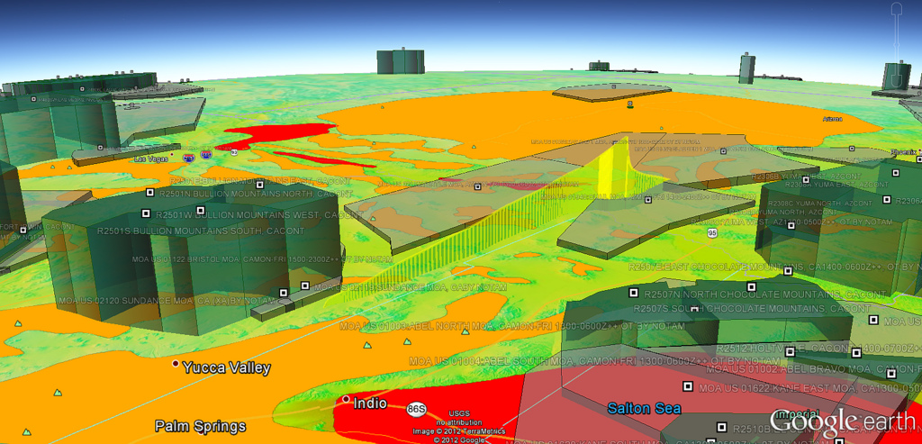
Don’t step on lava or military airspace

Slide 14
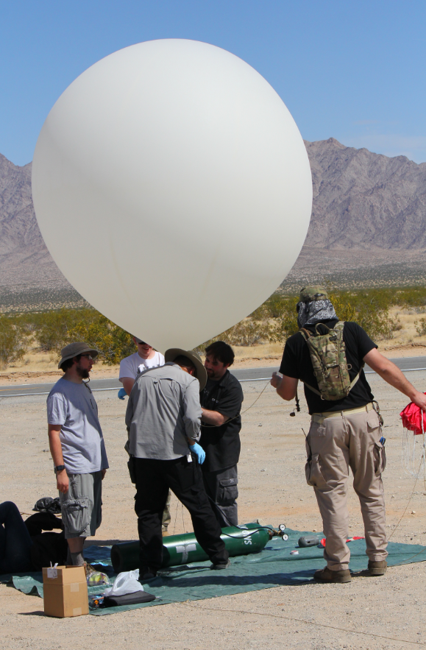
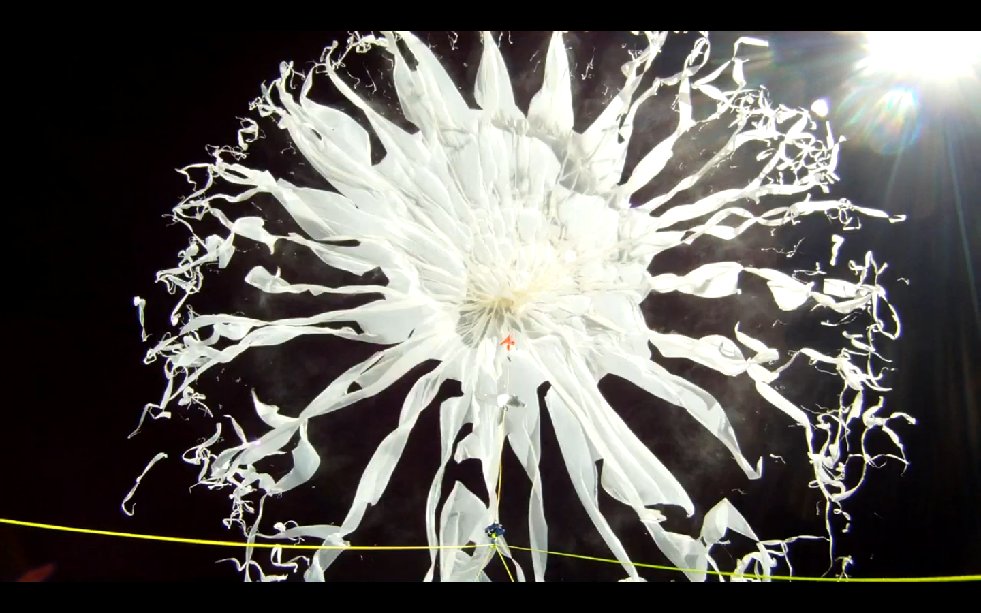
Balloon
Balloon manufacturers:
Kaymont and Hwoyee
Designed to shred (Totex)
Calculate how much to fill: habhub.org/calc
Neck lift → math to ascent rate/burst alt
Consider payload mass/balloon mass
Cost: $35 - $200
Notes:
- Balloon manufacturers, why the balloon are special, what they are made of, math behind ascent rate
- How to pick a balloon (target payload mass)

Slide 15
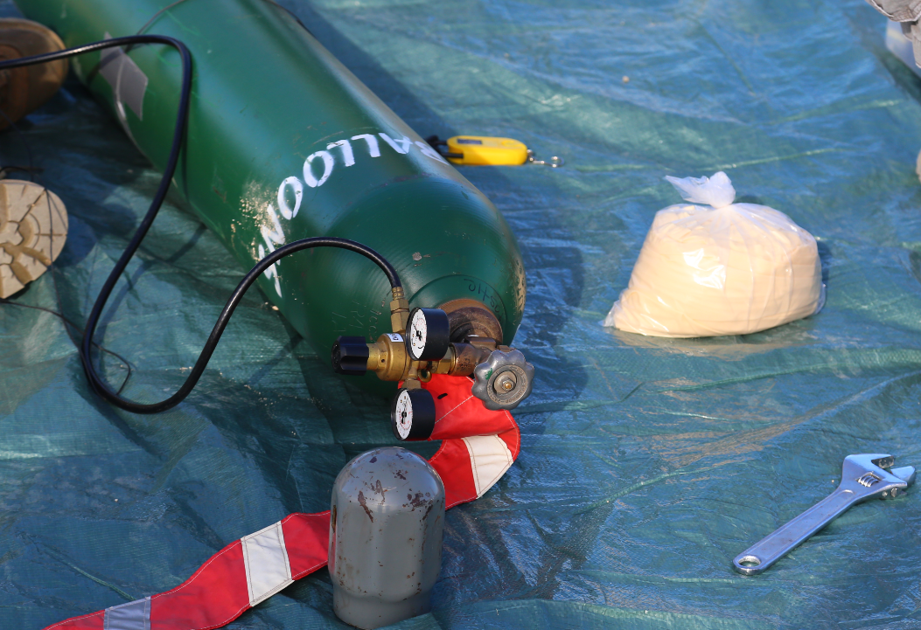
Lifting Gas
Hydrogen
PROS:
Cheap ($25 - $150)
High lift
Very available
CONS:
It goes boom, so you need to be careful (avoid public areas, don’t smoke near it, common sense)
Rate of ascent isn’t exactly constant
Helium
PROS:
Won’t kill you
You can launch from almost anywhere
CONS:
Expensive ($50 - $300)
….You’re going to need the proper regulators

Slide 16
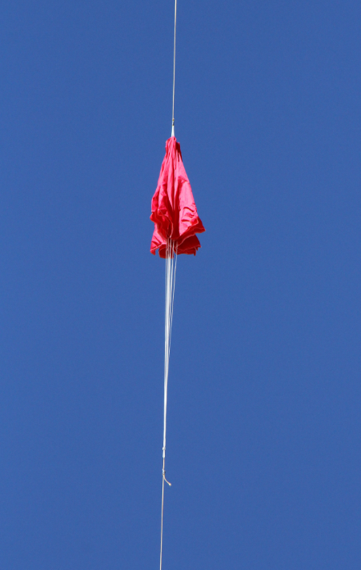
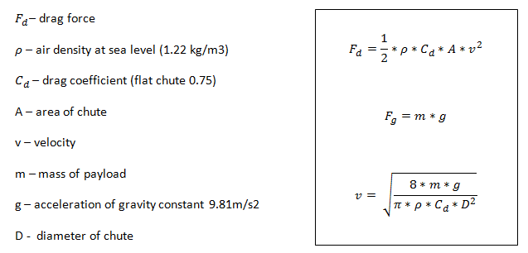
Parachute
Parachutes manufactures: Spherachutes
Made of rip stop fabric
Math behind descent rate
Drop to test
Cost: $5 - $60
- Pick parachute based on payload mass, table provided by Spherachutes (or do math)

Slide 17
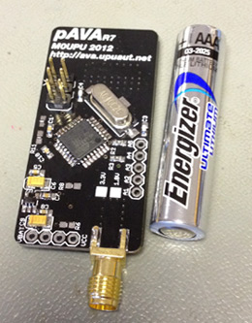
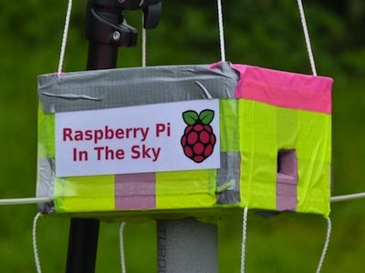
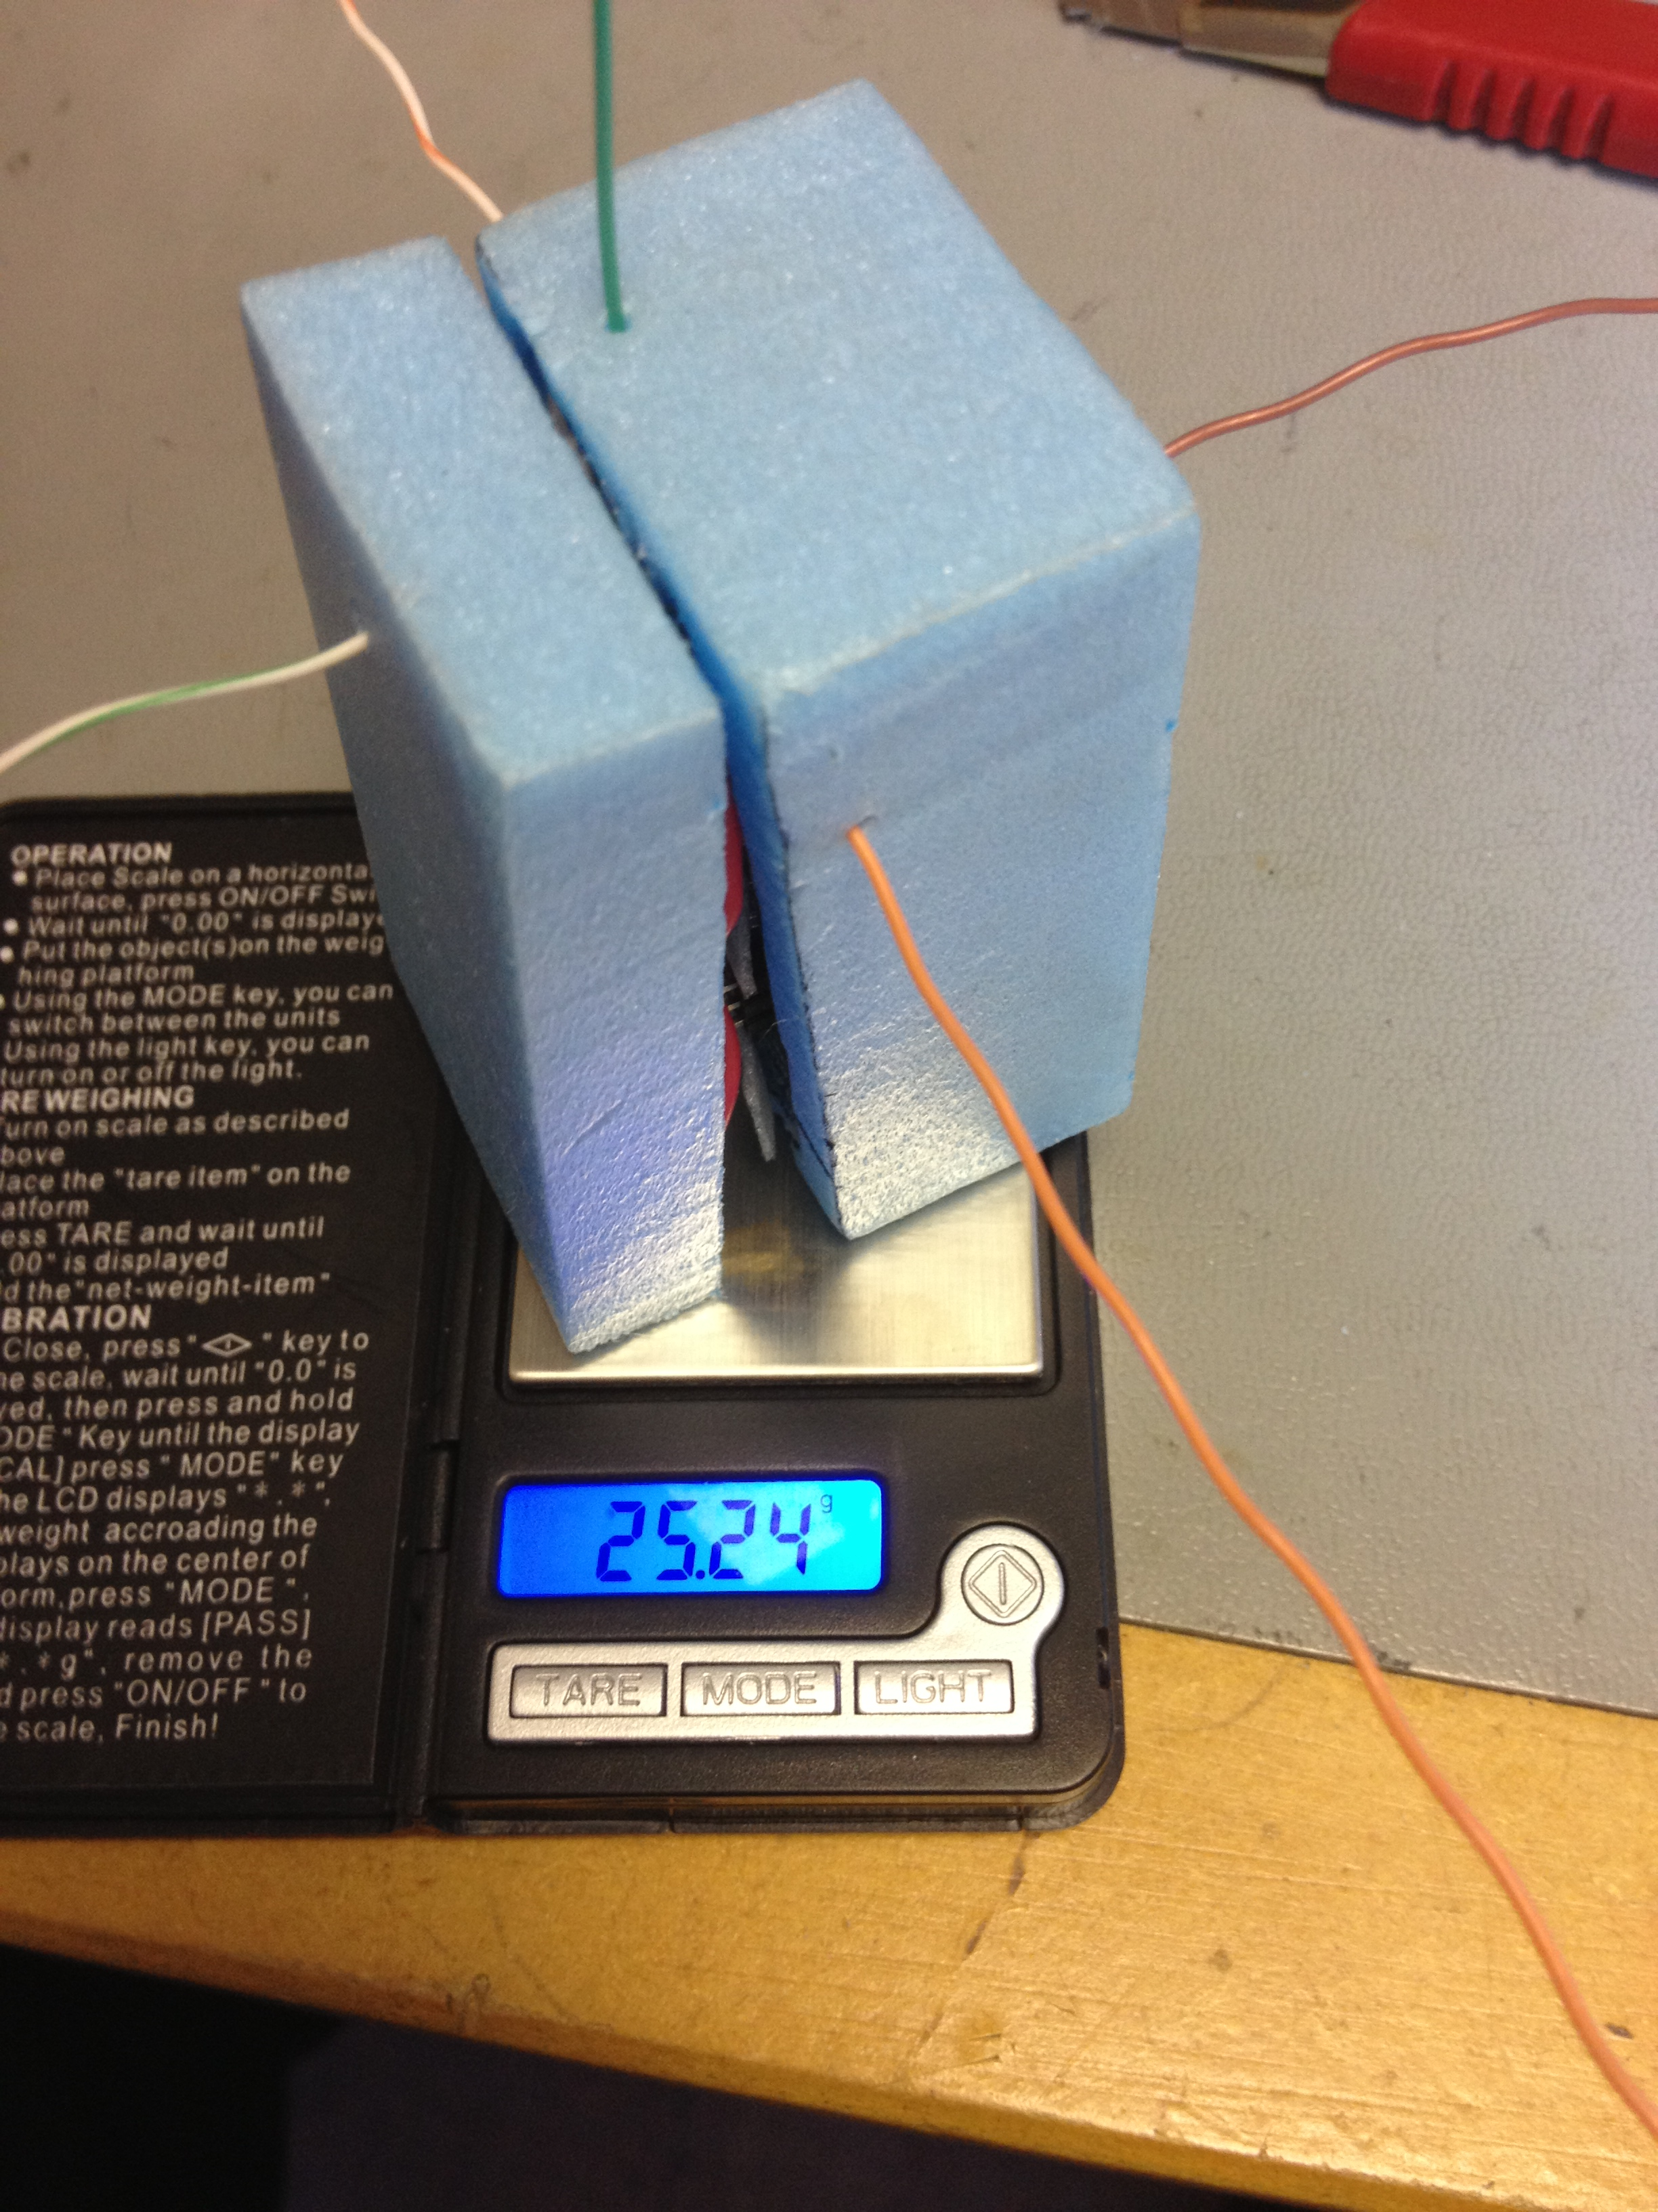
Payload Concept
Three general categories
Pico (not too regulated, 50g UK)
Small (FAA,CAA,CASA regulated)
MURICA (FAA,CAA,CASA regulated)
Pico
Small

Slide 18
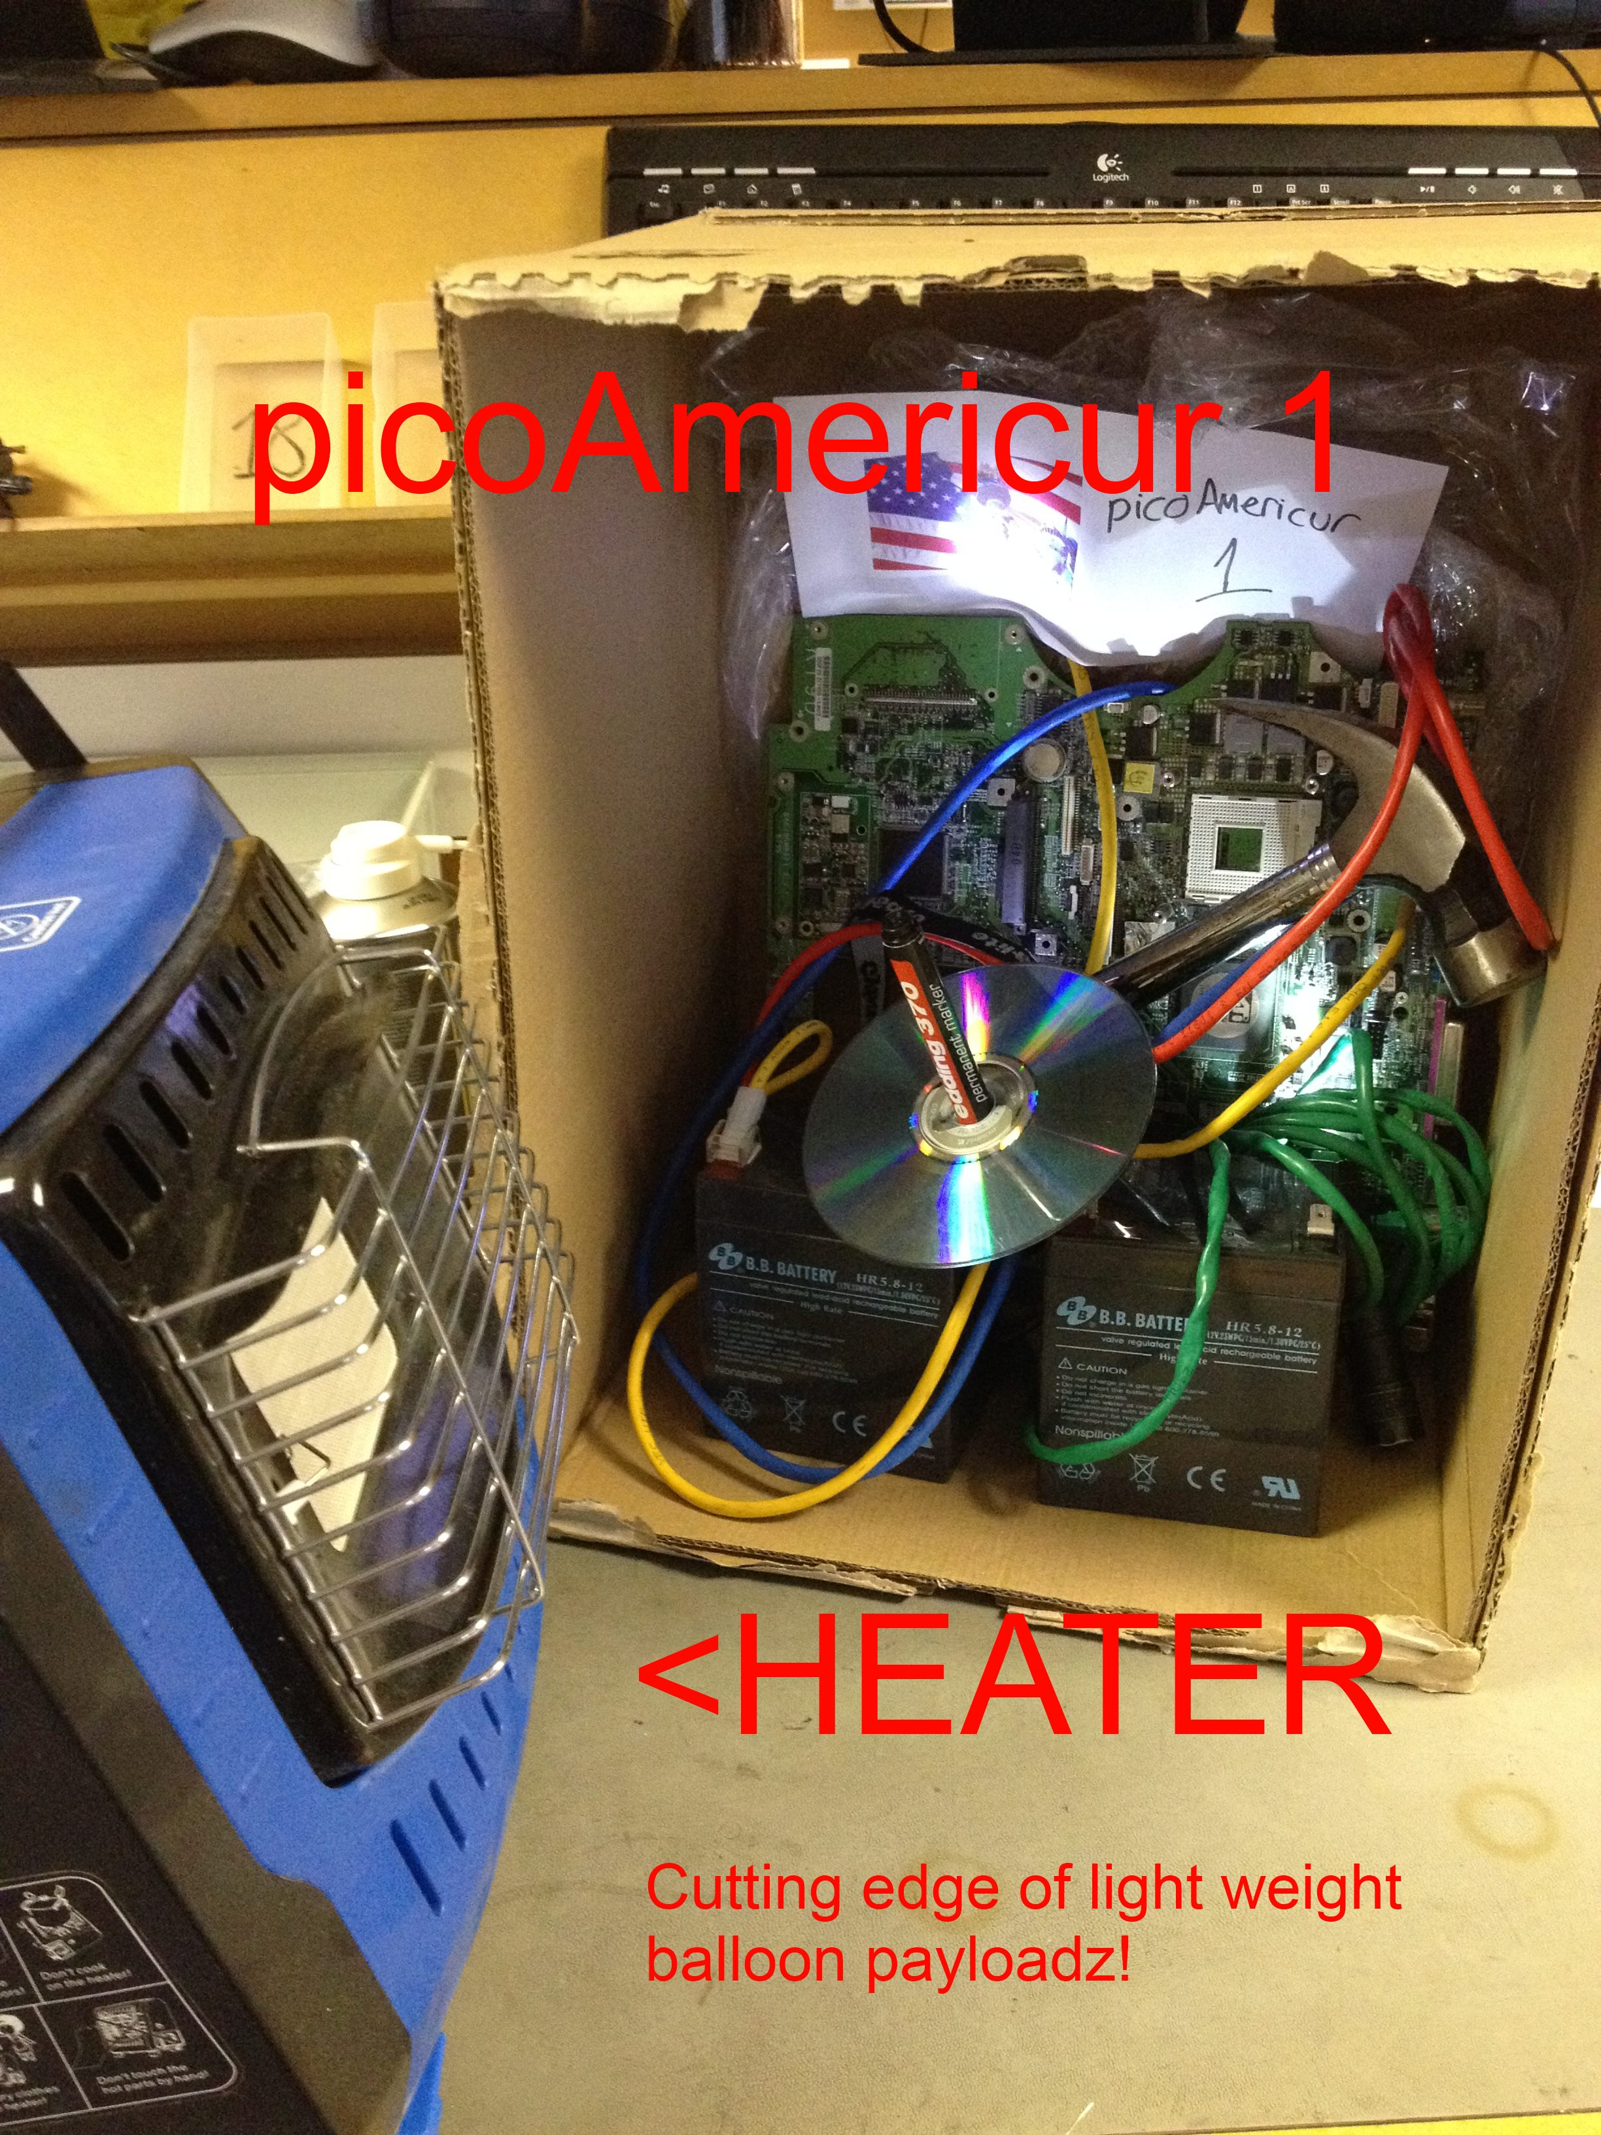
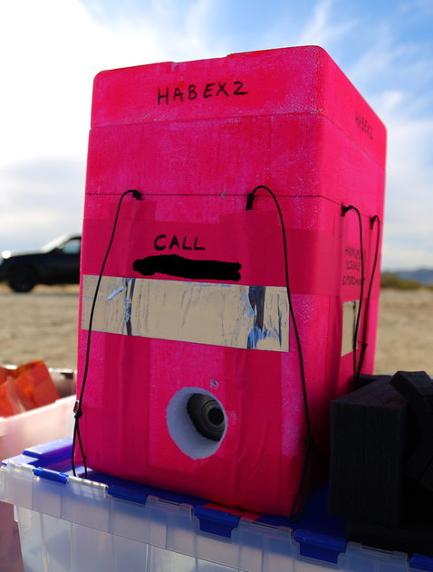
MURICA

Slide 19
Payload Comparison

Slide 20
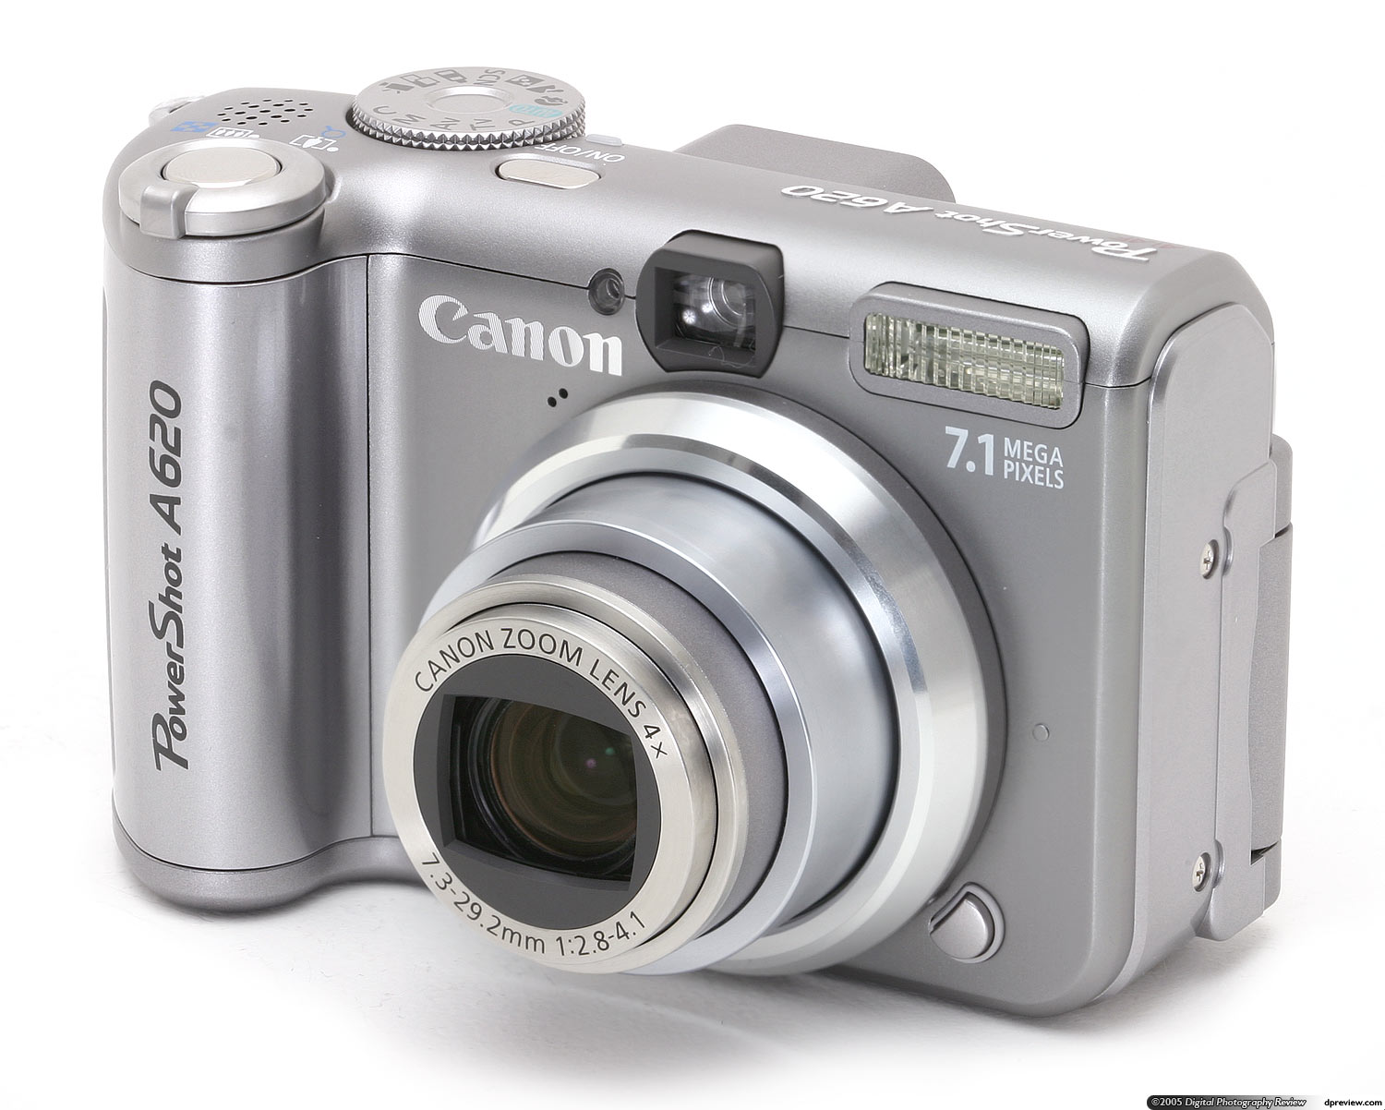
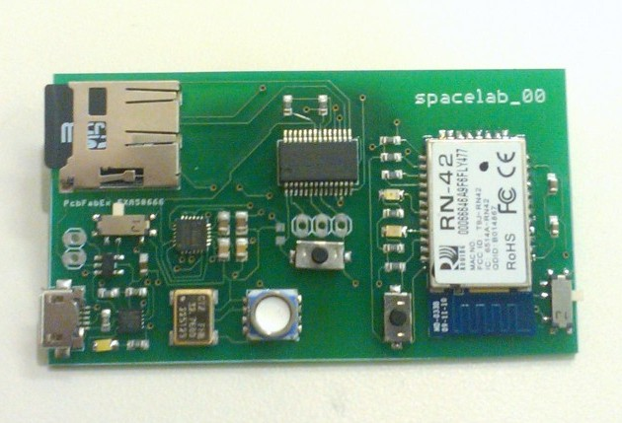
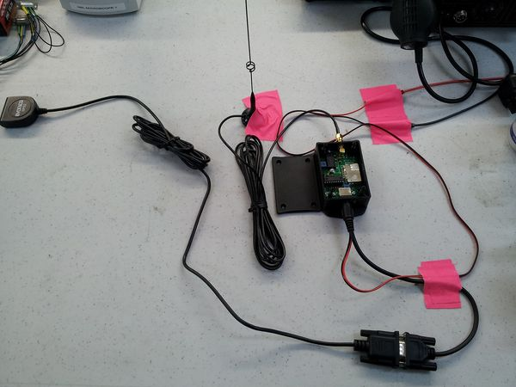
Payload
- Payload Camera
- You’re high, take some pictures
- Payload Science
- Take measurements, do science, test equipment
- Payload Radios
- Report position since the world is a big place
- 2-way communication for cut down and other features
Yo dawg, I’m at +34.123, -114.456 at 3000m off the ground...

Slide 21
Payload Radio
- APRS beacon (with GPS)
- 144.390Mhz (requires HAM license)
- RTTY beacon (with GPS)
- 434.075Mhz (requires HAM license in US, no license require for UK)
- 915.075Mhz (no license require for US, required for UK)
- Cellphone (with GPS)
- SPOT (with GPS)
- RDF Beacon (Radio Direction Finder)
-FM transmitter, tone
-Requires radio, directional antenna, maps, and compass

Slide 22
APRS (Automatic Packet Reporting System)
Specs?
Frequency: 144.390Mhz (USA)
Modulation: AFSK (Audio Frequency Shift Keying)
AX.25 protocol @ 1200baud
Who‘s listening?
A bunch of digipeaters along the United States @ 144.390Mhz
You can setup your own station
SDR
TNC to serial
APRSDroid
Ham radio with an audio output
(connects to audio input of computer), use an AFSK decoder.

Slide 23
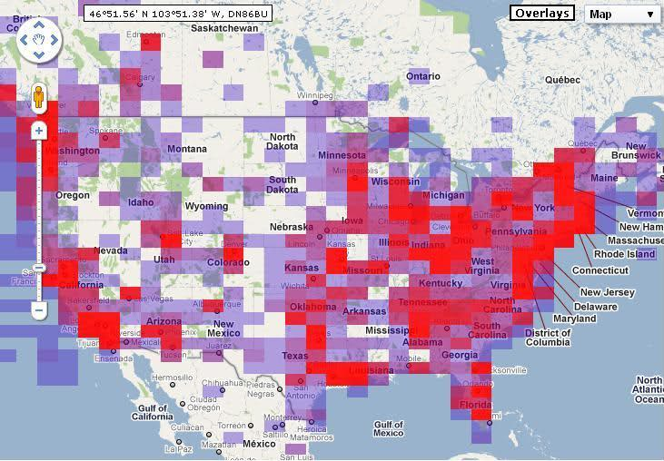
APRS Coverage

Slide 24
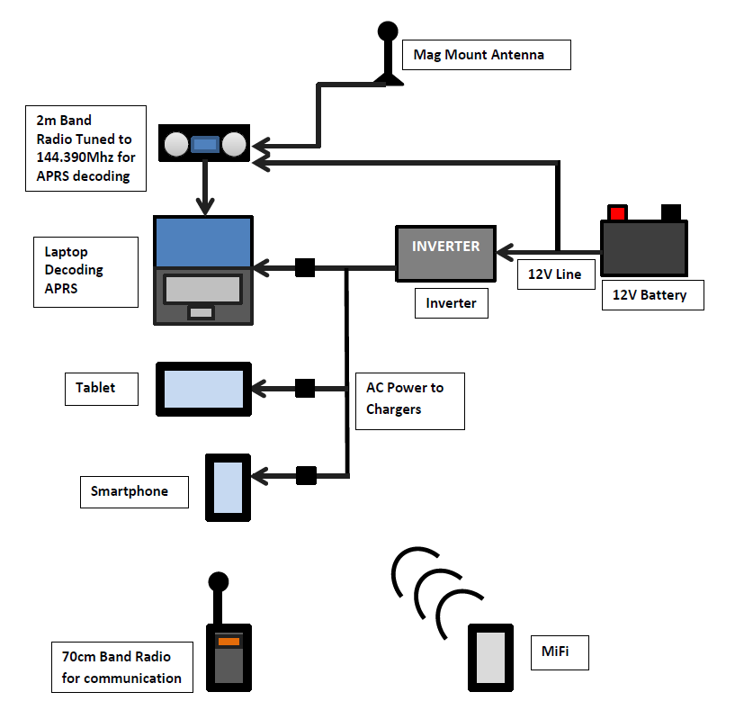
APRS Station
This could be:
- Chase Car Station
Ground Stations

Slide 25
APRS Beacon
NEMA PACKET
$GPGGA,123519,4807.038,N,01131.000,E,1,08,0.9,545.4,M,46.9,M,,*47
APRS PACKET
N6ARA/WIDE1-1/WIDE2-1>S4PRTQUI,?,F0:
`.+Gl#PO/"4q}HABEX|!V%@'b|!w!u!
GPS
Microcontroller
Radio
GPS Signal from satellites
Interface Devices
Configure any GPS/Radio settings
Reformat to APRS Packet
APRS packet transmission at 144.390Mhz

Slide 26
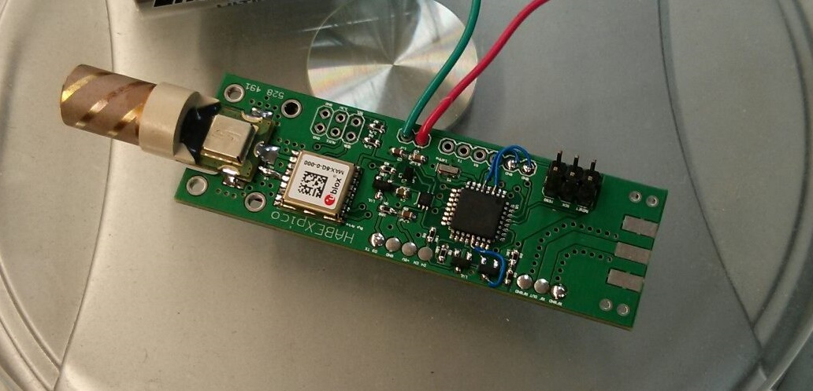
APRS Beacon
GPS
Microcontroller
Radio

Slide 27
APRS Beacon – HABEX2
GPS
Microcontroller
Radio

Slide 28
RTTY Beacon
Specs?
Frequency: 434.075Mhz-ish (UK, USA if ham licensed)
Modulation: FSK
Protocol: RTTY (Radioteletype)
Who‘s listening?
A bunch of radios along the UK @ 434.075Mhz-ish
You can setup your own station
SDR (active filter recommended)
Ham radio with an audio output
(connects to audio input of computer).
- Using “DL-FLDIGI” to decode and upload information to internet

Slide 29
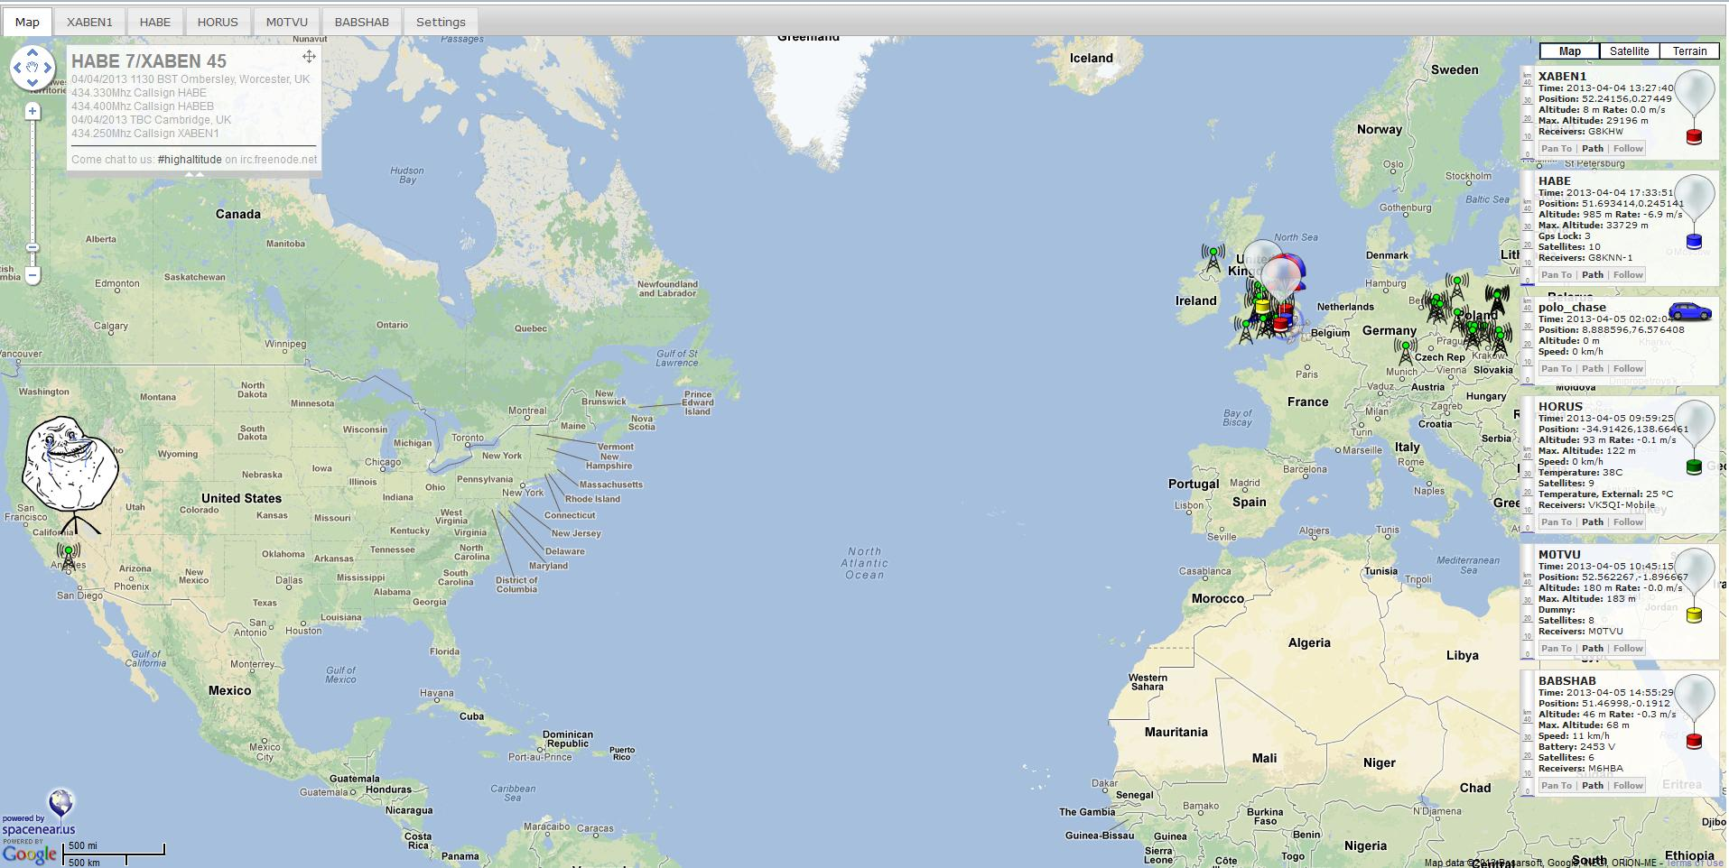
RTTY Who’s listening?

Slide 30
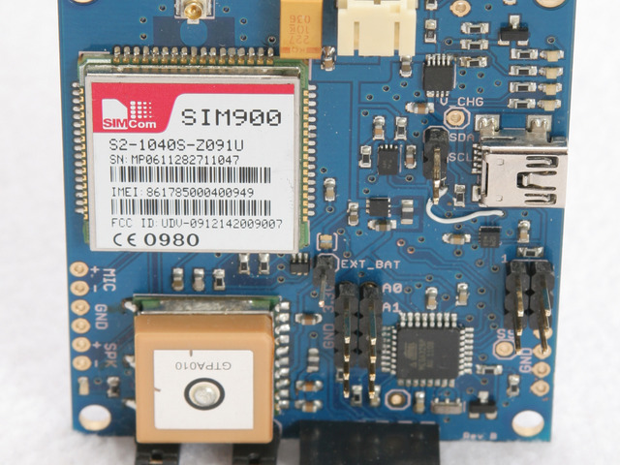
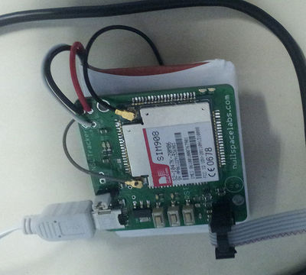
Cellular based tracker
Nullspace Labs – “NSL Tracker”
DSS Circuits
Android phone
Pretty much any phone that can be programmed and has GPS
NSL Tracker
DSS Circuits – Geogram One

Slide 31
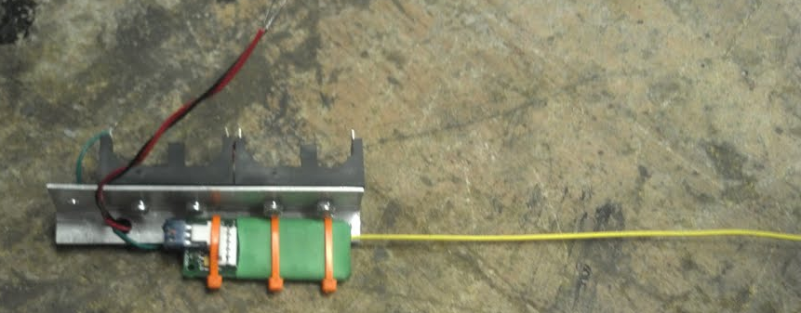
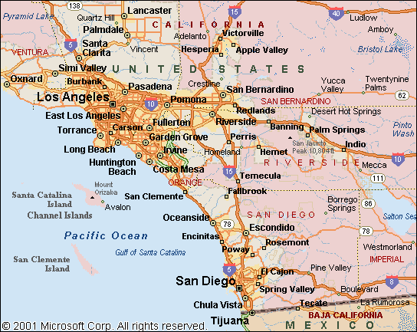
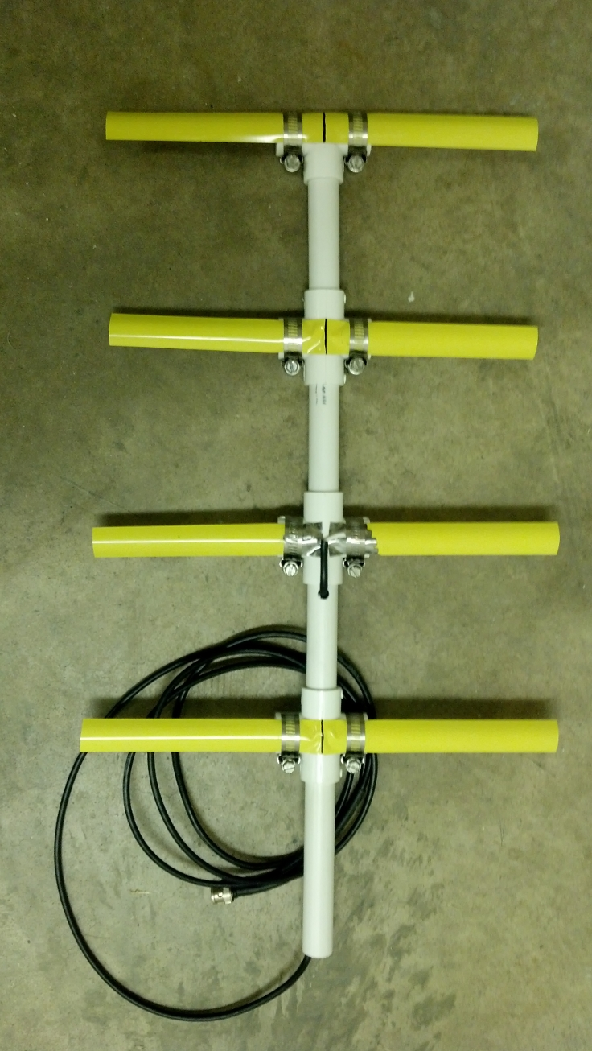
RDF Beacon Radio Direction Finder
Beacon transmits an FM Tone
Using a directional antenna and a ham radio with a speaker
3 samples, find the point!

Slide 32
Payload Tips/Guidelines
Watch cho mass
budget mass for everything
Balloon
Parachute
payload radios, payload camera, payload science
measure mass as you go
Power devices separately
Redundancy, Redundancy, Redundancy
Different radios, powered separately
Simple designs are the best
Plenty of insulation (Expanded or Extruded Polystyrene) (Closed cell)
Learn to tie good knots
DO A CIRCUIT & SYSTEMS ANALYSIS
TEST TEST TEST TEST TEST TEST TEST TEST TEST TEST TEST

Slide 33
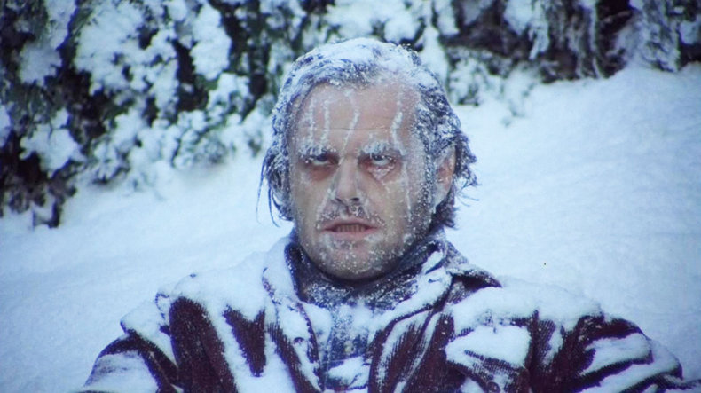
Should I bring a coat?
- Near space is cold: -60C to +40C
- Near space is a near vacuum: 0.01atm (1010Pa) - 1atm (101325Pa)
- Mountains
- Lakes/rivers/H20
- Volcanos
- Expected Winds: 1-3g , 80+mph winds (releative to air pressure)
- Flight time: 1hr – 2hrs (floaters could last 24hrs+)
- Electronics don't like these things (I’ll cover this soon)

Slide 34
Prototype & Test & Revise
Build and test prototype in normal (1atm @ 25C) and work out software bugs
Try to build two:
Mod it, fix it
Beat it up, test it, revise it
Apply final revisions to flight hardware and do environmental testing
- Plan for failures (GPS signal loss, GPS chip comm loss, backup plans, resets, etc)
Flight Hardware
Test Hardware

Slide 35
So you think you've got a HAB?
- Does it pass basic tests?
- power up, find gps, transmit position (tested on battery)
- block gps, does it go into beacon mode?
- checksums
- radio range, climb a mountain and transmit, test your ground stations
- chase the payload
- Power calculations
- measure actual lifetime
- aim for double what you expect your flight time to be
- Test your ground equipment
- software decoding ok?
- find problems and fix them now and not on launch day
- shocking how simple it is, yet it can be overlooked
- Rope useage (have a layout on how to avoid things tangling)

Slide 36
Near Space Environment
1) Wind
- undo connections
- break things
- rip the payload apart
2) Temperature
- cold temperatures can kill hardware
3) Vacuum
- lack of air could cause parts that rely on
convection to cool to overheat
4) EMC
- your radios could crosstalk, step on each other
- signals could couple and damage
Notes:
- Wind (Why? Winds can knock the payload around an undo connections, break things, rip the payload apart)
- Temperature (Why? Cold temperatures can kill hardware)
- Vacuum (Why? Lack of air could cause parts that rely on convection to cool to overheat, go over convection,conduction,radiation)
- EMC (Why? Your radios could crosstalk, step on each other, couple and damage)
- Parachute descent rate (Why? You want to get an accurate descent rate to better predictions)

Slide 37
How to fix ENV problems
Winds:
tie downs, hot glue, connectors, tape
Shaking:
throw it down stairs, if it’s fine, it’s good to fly
Vacuum/Cold
apply either Silicone, Epoxy, or Urethane conformal coating
ghetto solution: hot glue
thermally "lump" it together and prevent shorting and damage
EMC
Better design RF or keep em separated (rope apart / sheilding)
Test all the radios and equiptment together

Slide 38
Flight Prediction
- Habhub CUSF Flight Prediction software
- http://habhub.org/predict/
Gives you estimate landing location based on
launch location
ascent/descent rate
burst altitude
using NOAA wind data
- Prediction/Simulation is only as good as the numbers you give it
- Work to get exact:
- Balloon necklift (ascent rate)
- Parachute drag (descent rate)
- Payload mass (ascent/descent rate)
- Accurate launch time
- Run predictor from multiple launch locations and have a backup or two

Slide 39
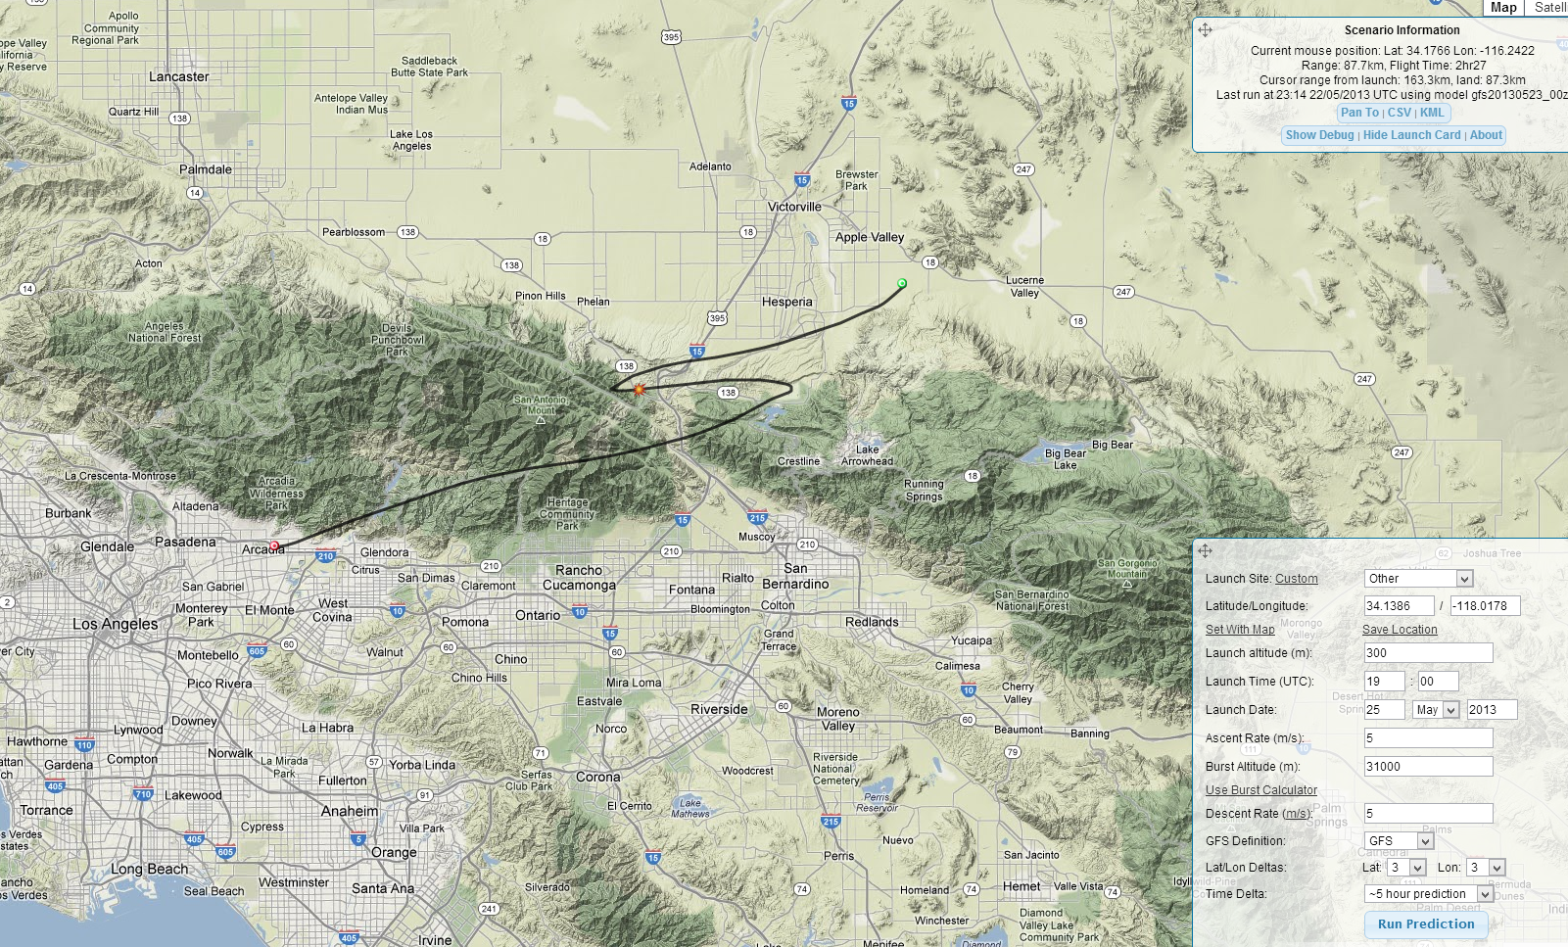
Habhub CUSF Flight Predictor

Slide 40
Launch/Recovery Day
Practice runs, wash out any problems
Have a checklist and packing list
Communications
Radio net, cellphones, yelling across the desert
Give people a report with contact info/plan/etc
Note every measurement (neck lift, time of release, etc etc)
If it lands in an easy spot, ask for permission to go on property if needed
If it lands in a bad spot, regroup, figure out approach, and come back another day if you need to.

Slide 41
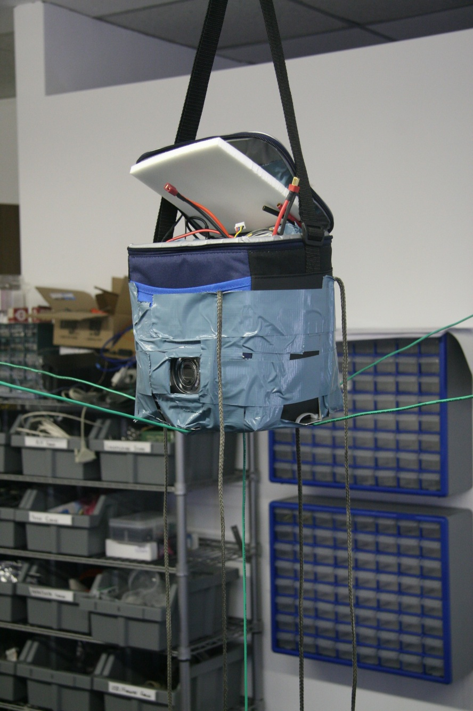
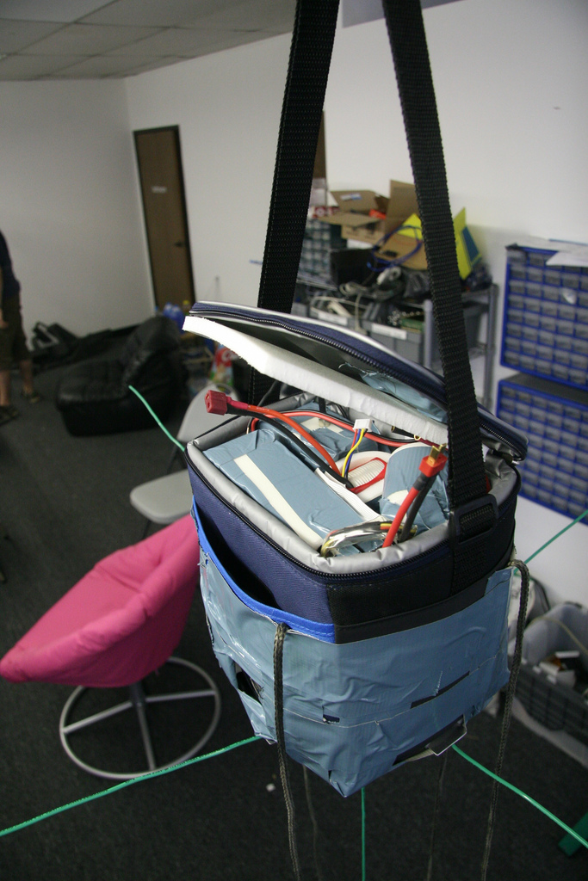
HABEX 1

Slide 42
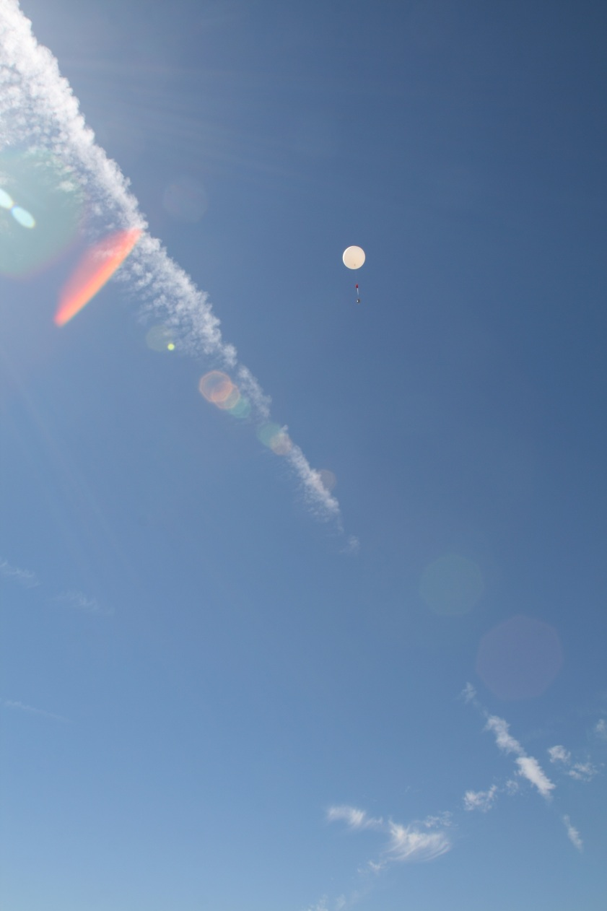
HABEX 1

Slide 43
HABEX 2
RDF Beacon
MicroTrak RTG HA
NSL Tracker
SpaceLab_00
Temp
Acc
Gyro
Mag
Pressure
Hacked Canon (CHDK)
Notes:
HAB1200 Balloon
48” Spherachute
Payload
Primary Radio: MicroTrak RTG High Altitude (with mods)
Secondary Radio: NSL Tracker (cellphone based)
Tertiary Radio: Arclight’s RDF beacon
Science Payload: Measure temp, acc, gyro, mag, pressure
Canon Camera using CHDK

Slide 44
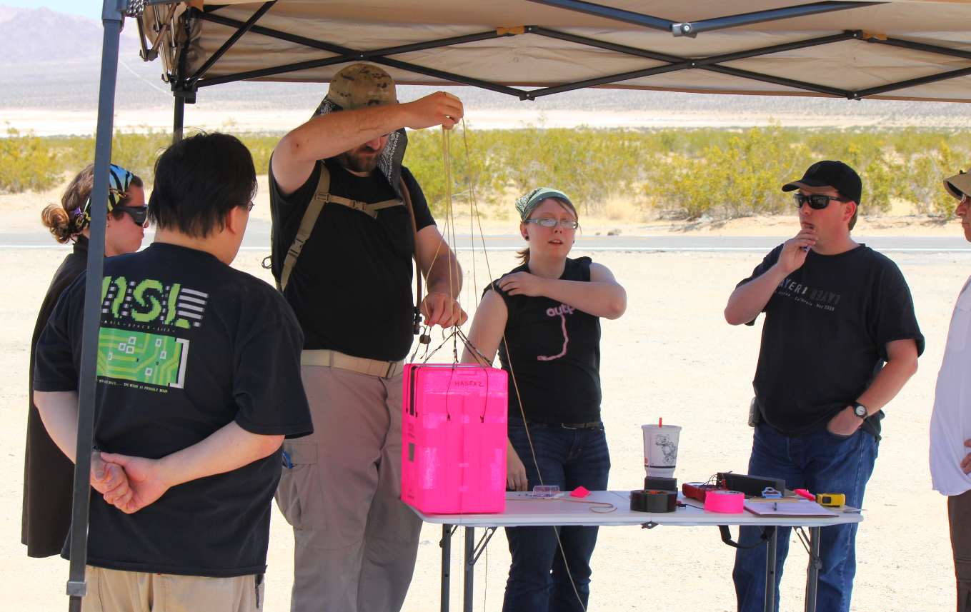
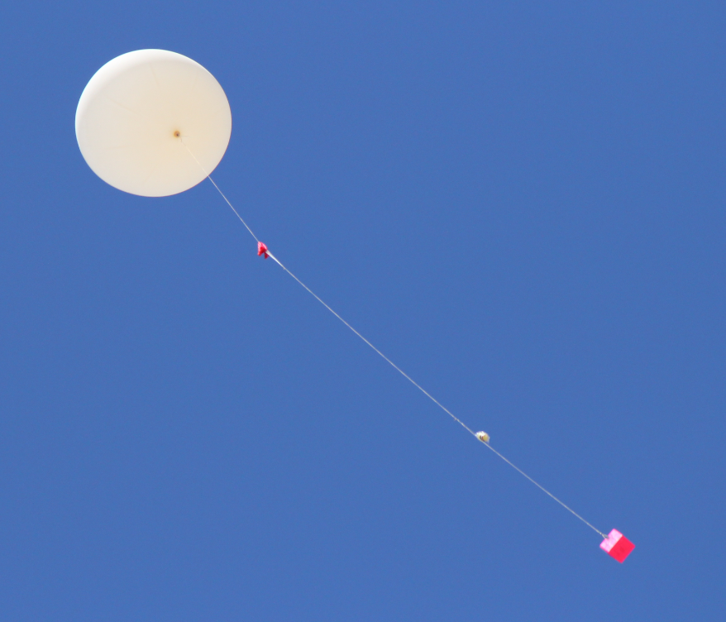
HABEX 2
Notes:
- BIG TEAM

Slide 45
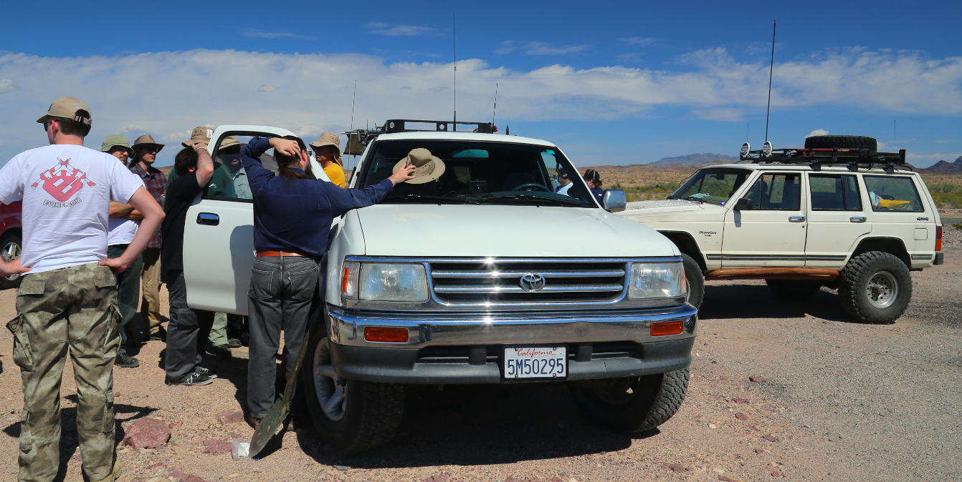
HABEX 2
Notes:
- BIG TEAM

Slide 46
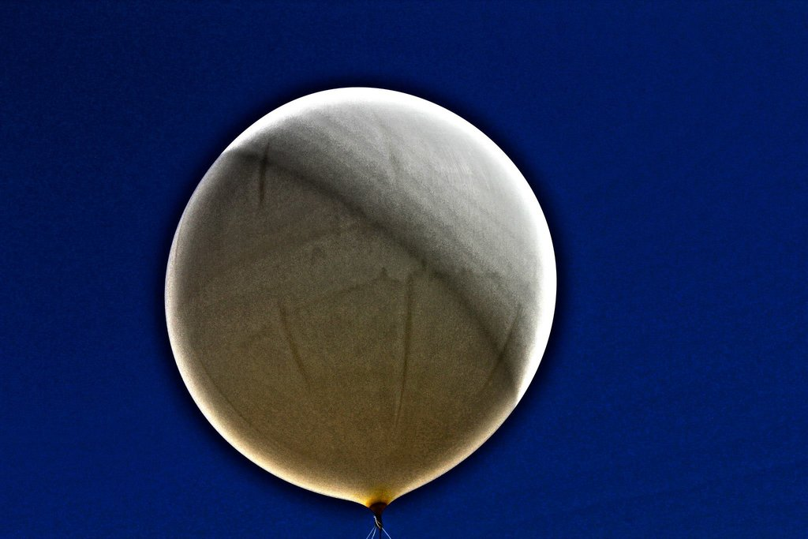
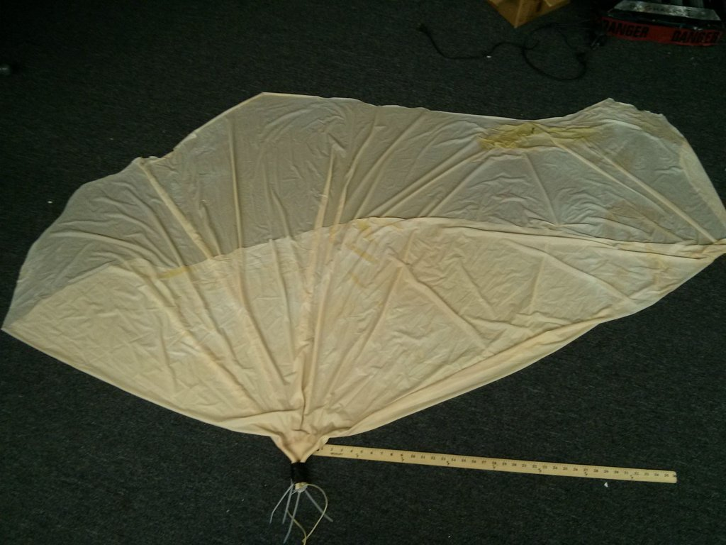
HABEX 2

Slide 47
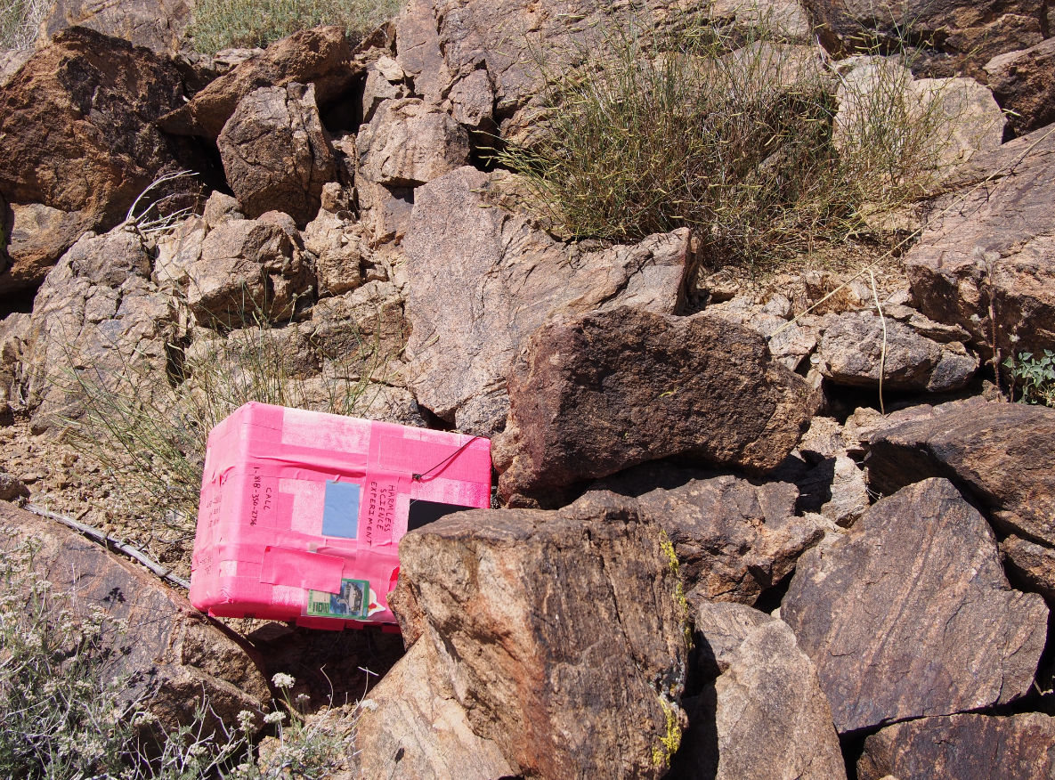
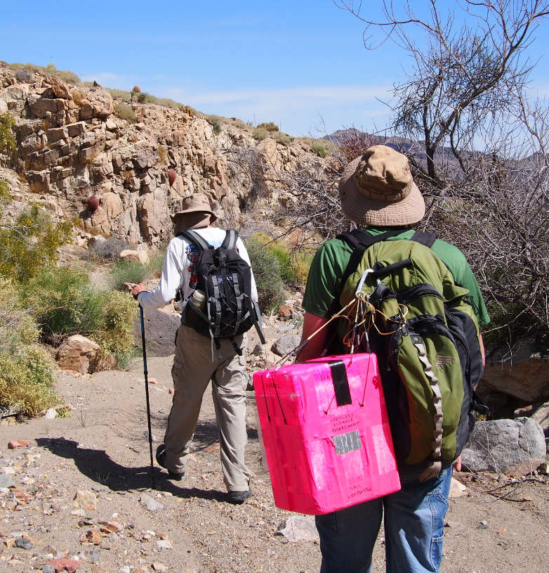
SB Search and Rescue

Slide 48
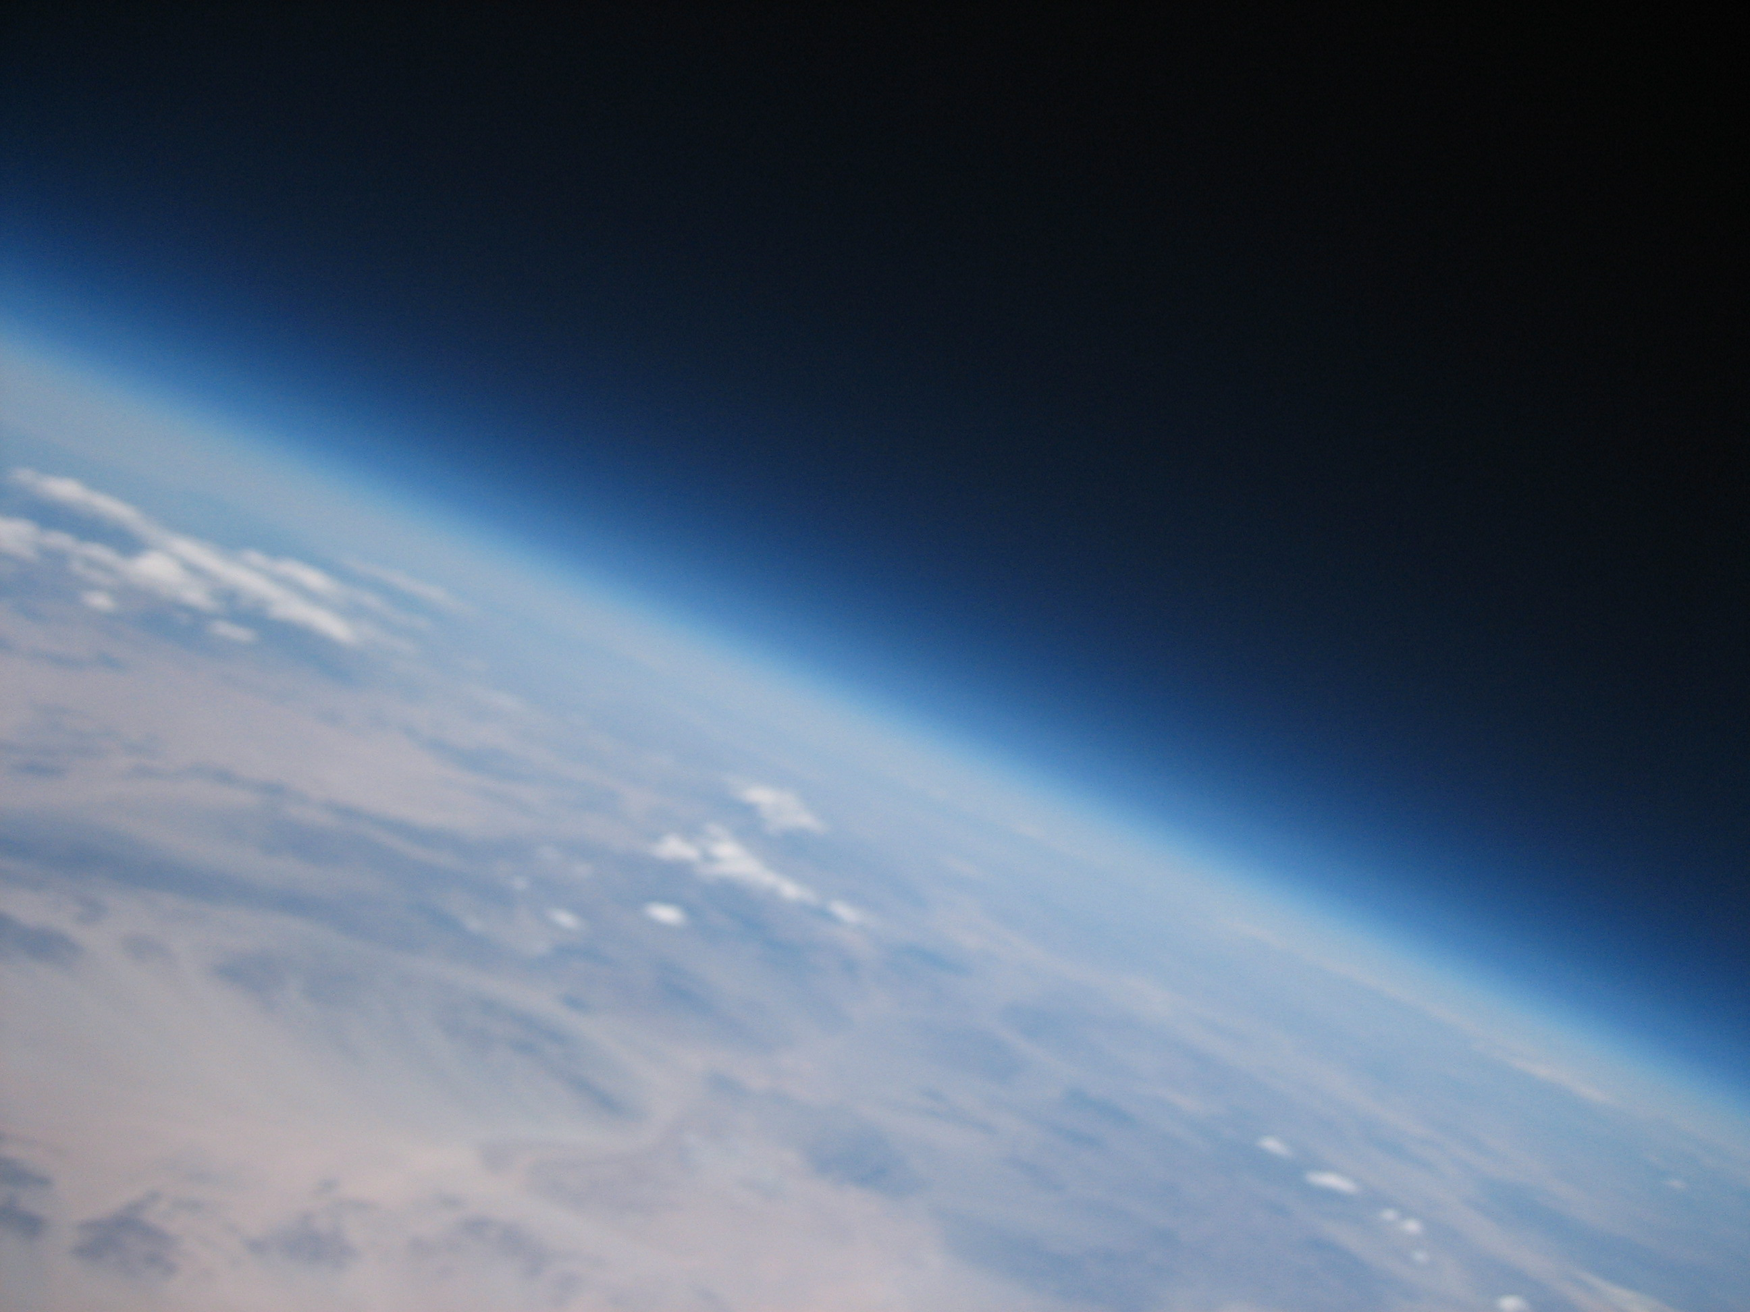
HABEX 2 Pictures

Slide 49
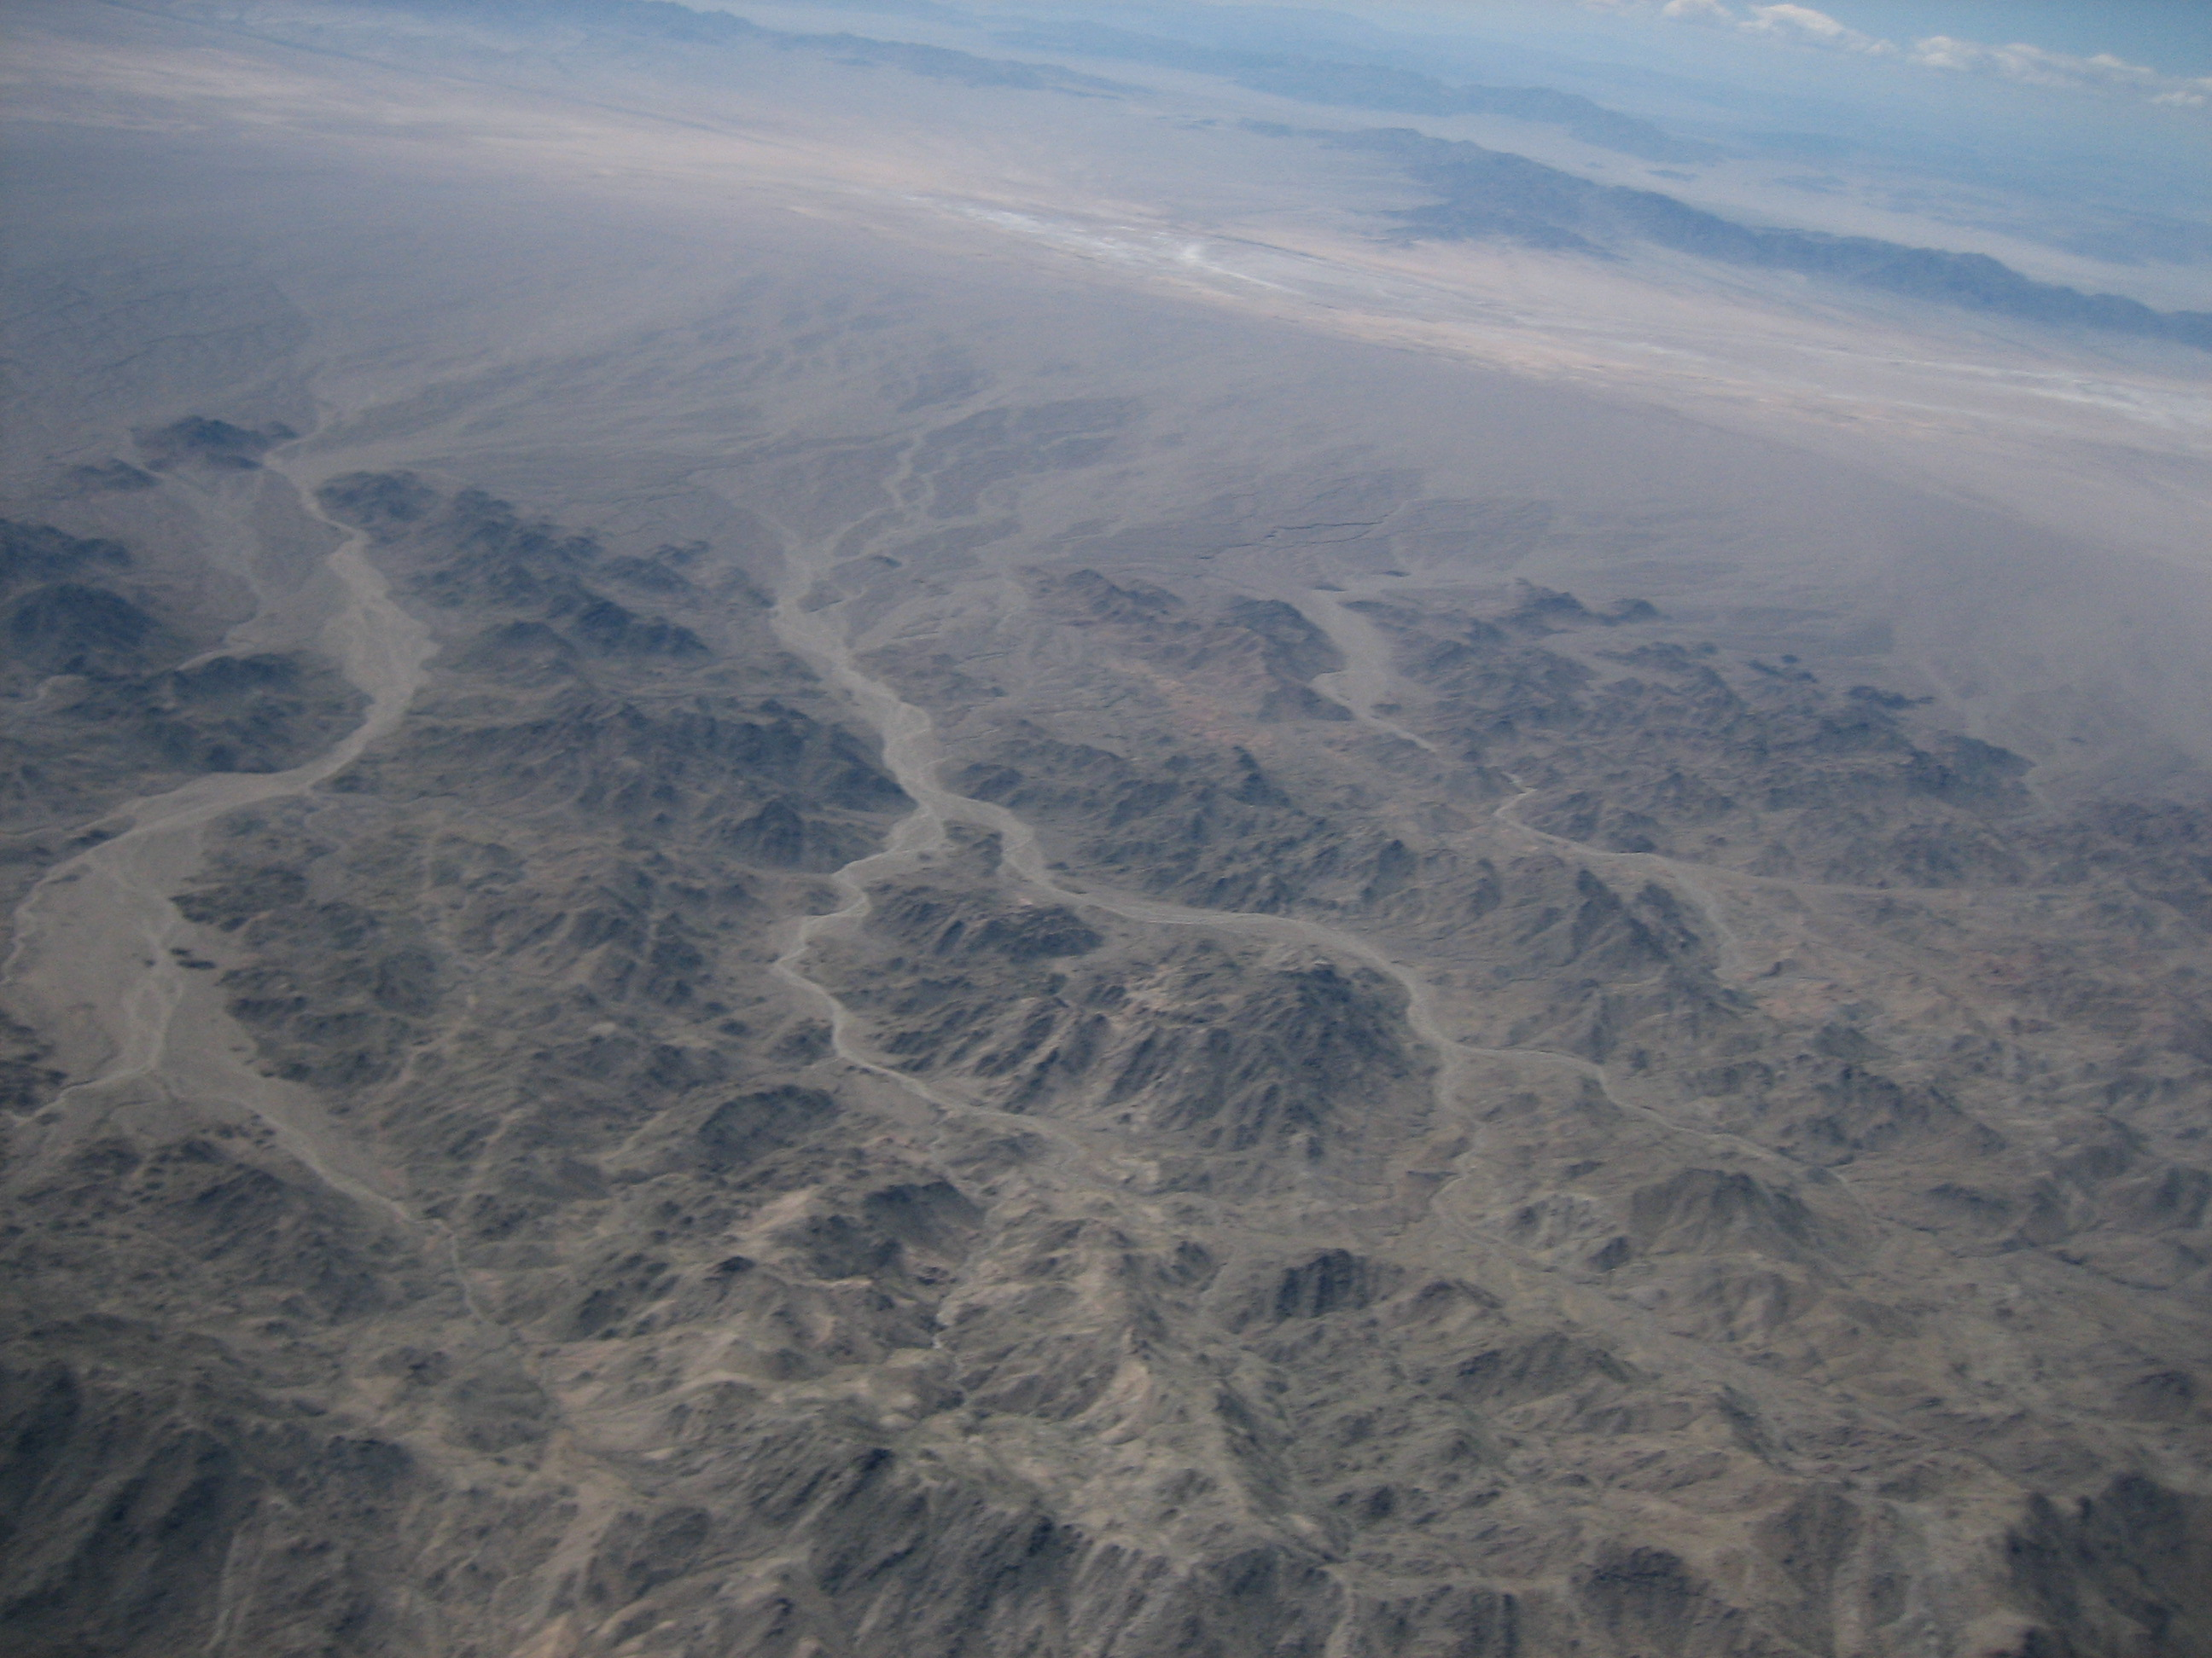
HABEX 2 Pictures

Slide 50
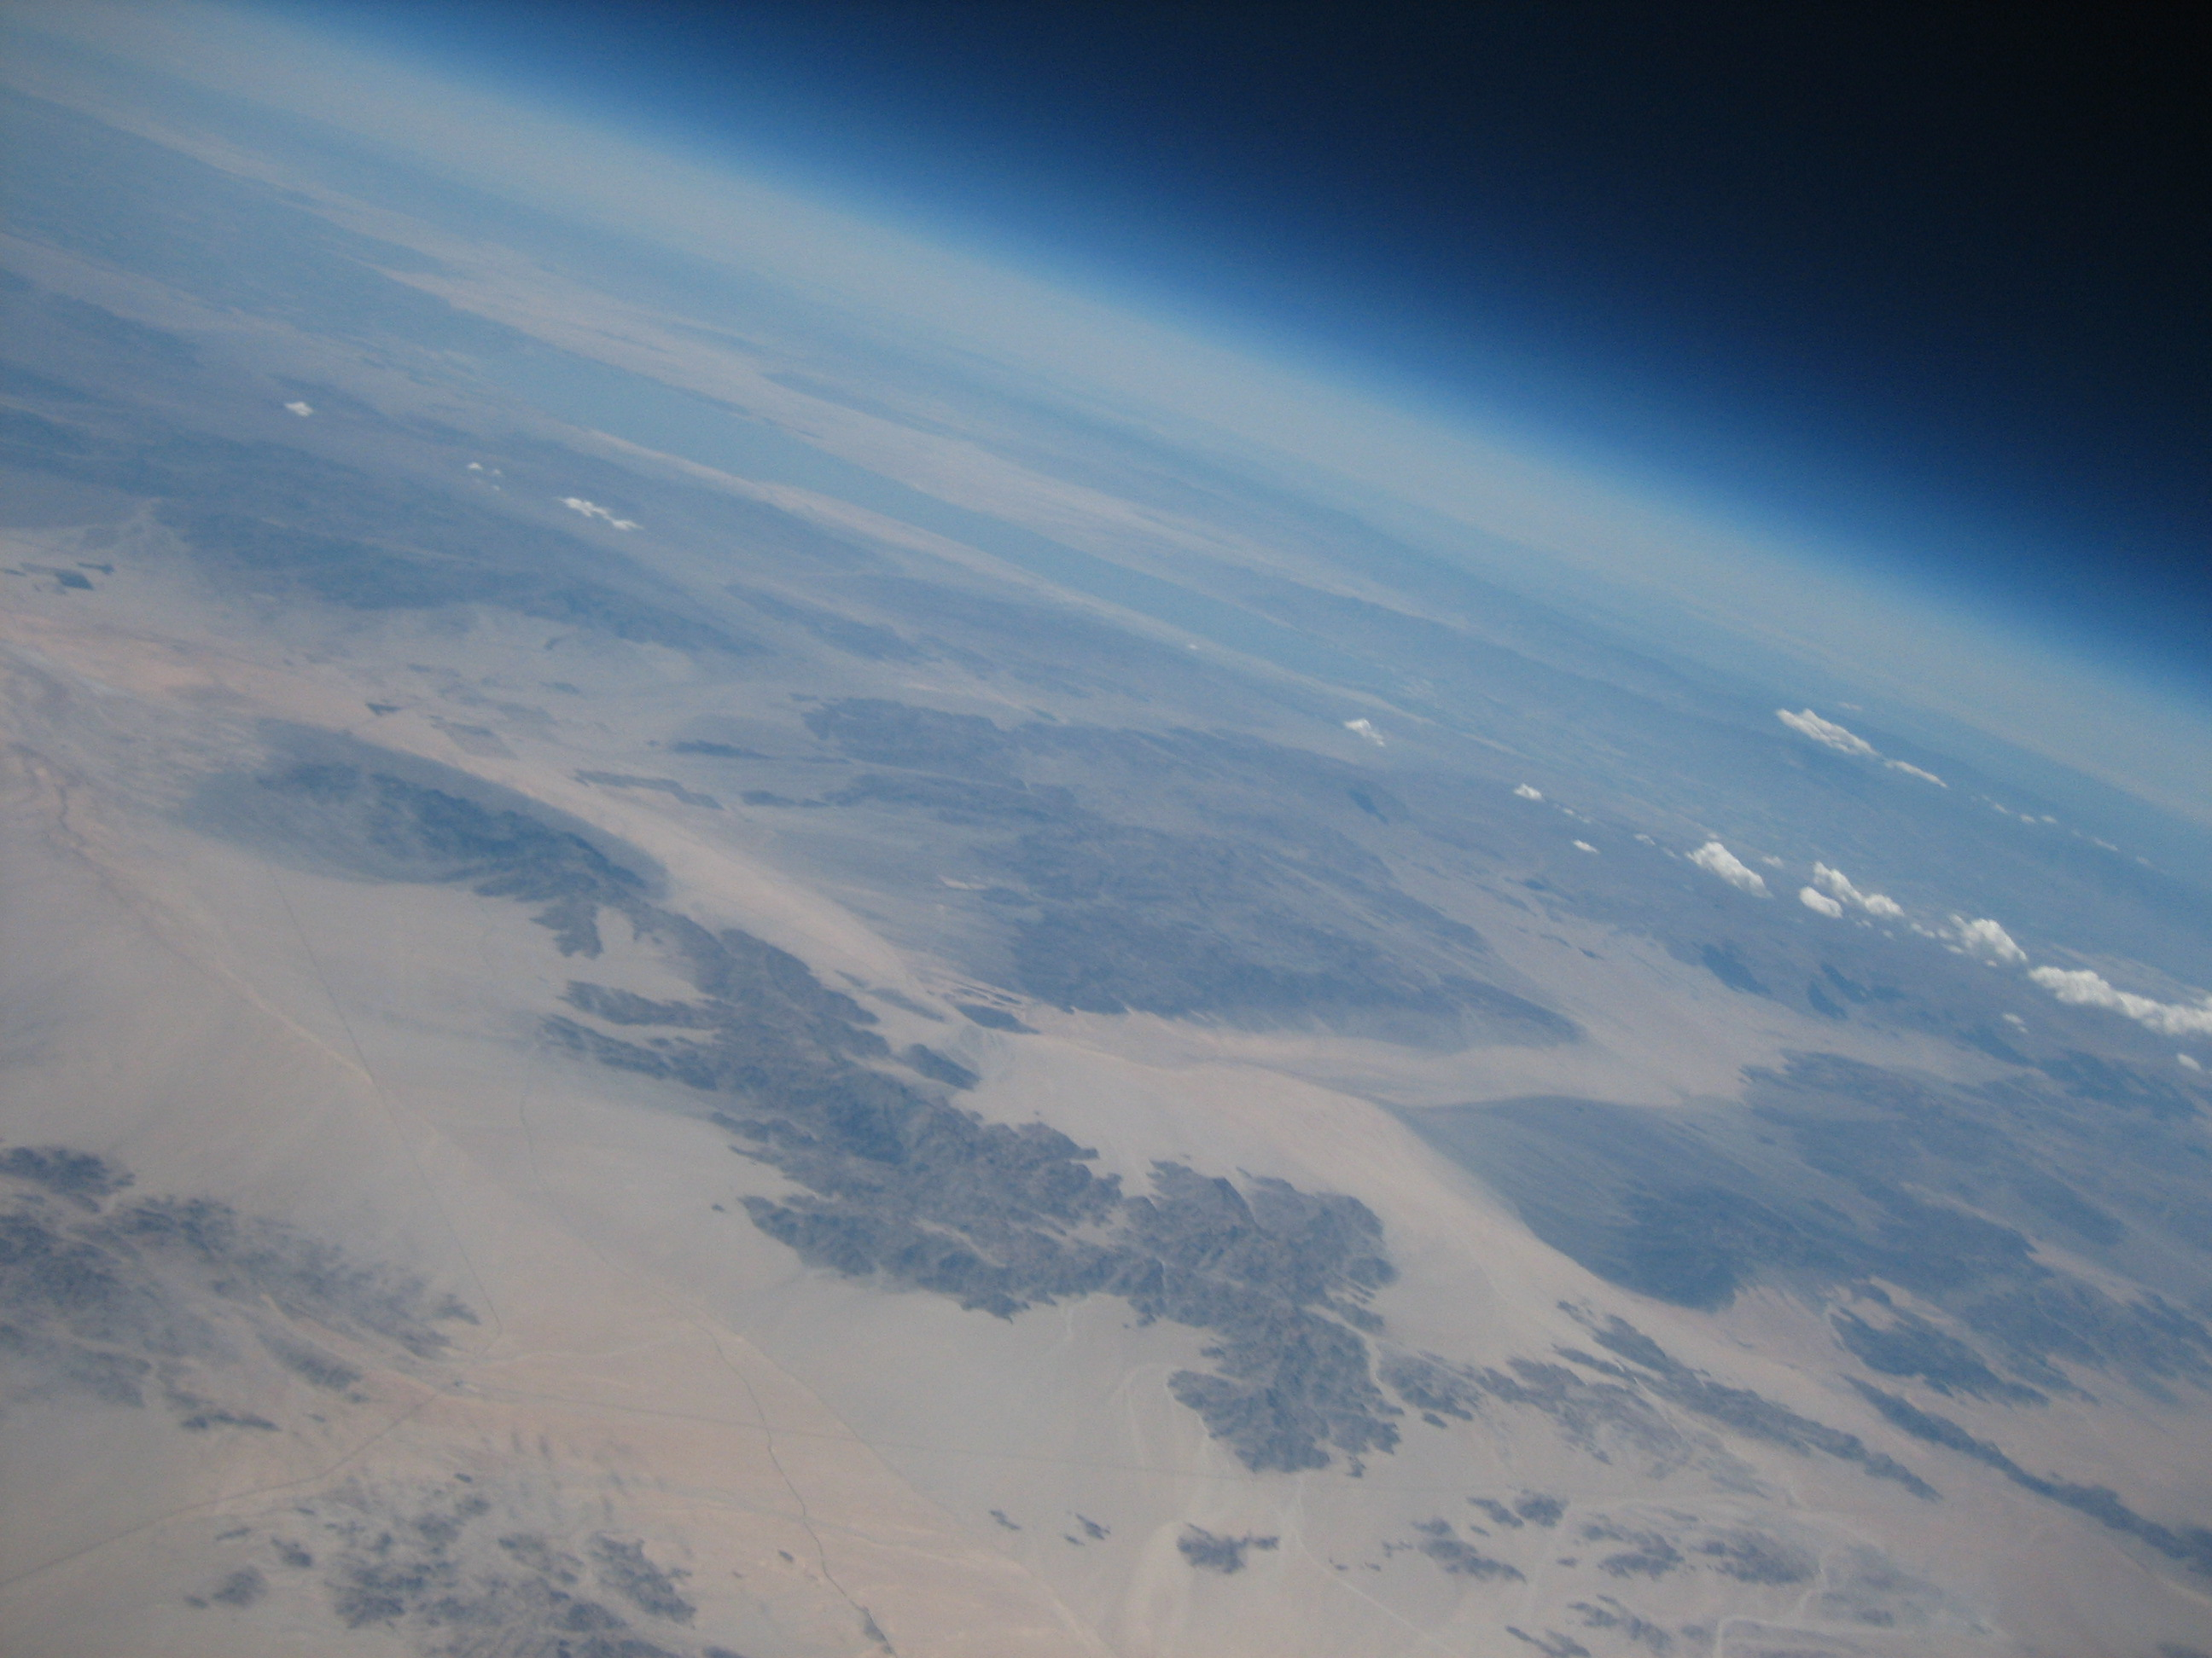
HABEX 2 Pictures

Slide 51
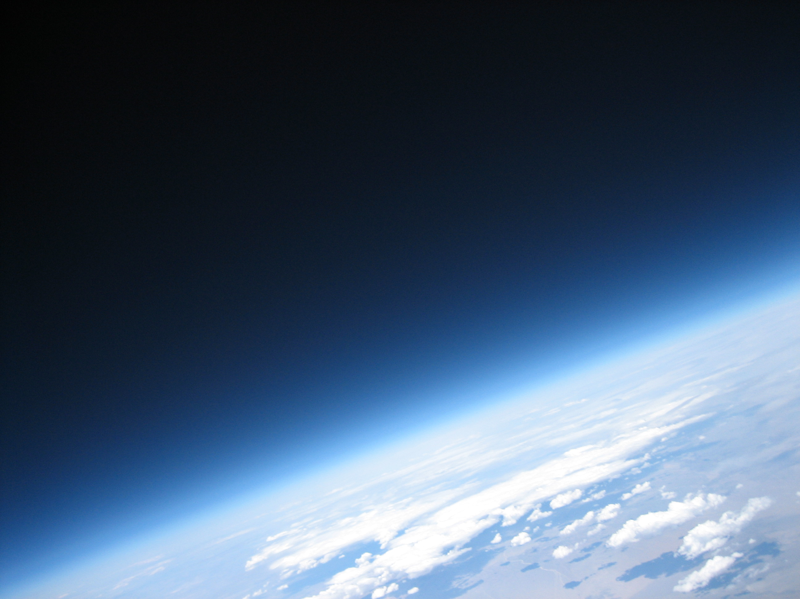
HABEX 2 Pictures

Slide 52
HABEXpico
Launching outside NOW: noon to 1pm
No picture this time.. just testing a radio and doing a launch for $150

Slide 53
UKHAS Conference 2013
Come to London!
September 7th, 2013
1 Day conference
More indepth talk about environmental testing
HAB’s & beer

Slide 54
ZEH EHND
Special thanks to:
Nullspace Labs
HABEX2 Launch and Recovery team!
Arclight
UKHAS
More info:
http://wiki.032.la/nsl/HABEX2
http://ukhas.org.uk/

