Slide 1
HABEX 2: HAB Harder
Arko

Slide 2
What’s a HAB?
Concept:
Fill a balloon with a lighter gas (He)
tie a tracker to it
let it go
track it
go pick it up when it lands

Slide 3
HABEX2 – Mission Overview
Target Burst Altitude: 31,000m
Current Estimated Ascent Rate: 5.83 m/s
Current Estimate Decent Rate: 6.37 m/s
Current Payload Mass Estimate: 4 pounds or 1.81kg
Required Helium: 4.65m3 or 164 cu-ft or 4646L
Launch Time/Date: Saturday March 30th, 2013 at 10:00am
Launch Location:
Latitude 34.1318 deg N
Longitude -115.9094 deg W
Altitude 395m
Launch/Landing Estimated Time Duration: 2 Hours 00 Minutes

Slide 4
HABEX2 - Goal
Launch, Track, Don’t land in a shitty place, Recover
Looks innocent right?

Slide 5
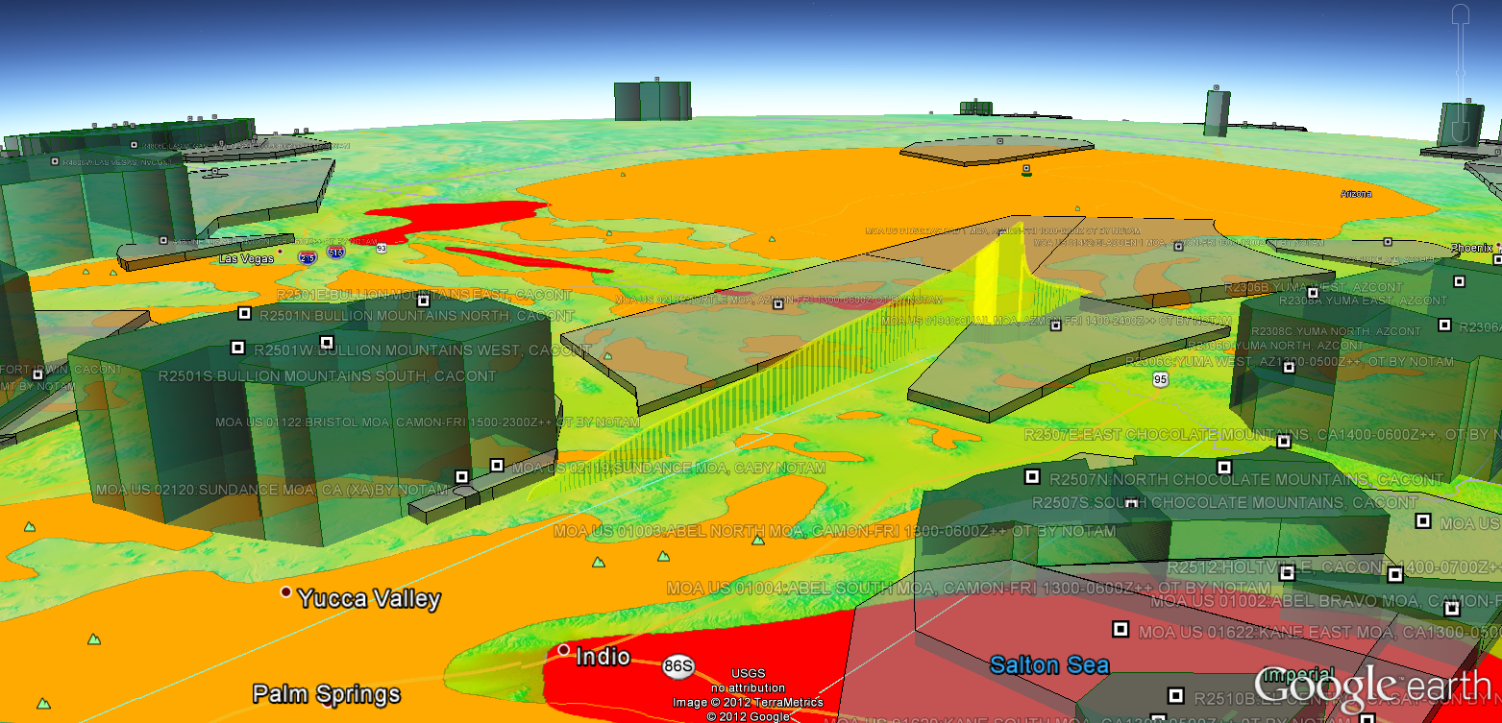
Don’t hit shit, stay out of the way

Slide 6
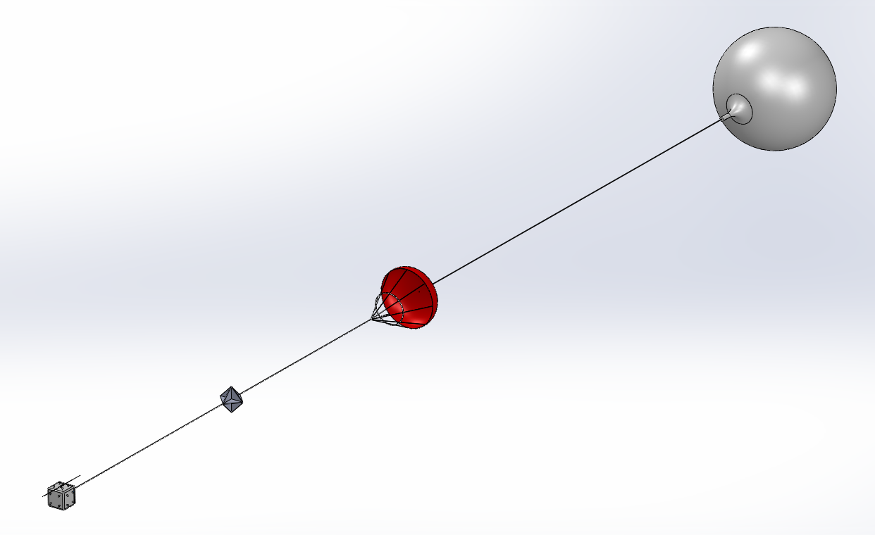
Design Overview
Balloon
Parachute
Radar Reflector
Payload
Payload
GPS enabled APRS beacon
Cellphone network based tracker
RF chirping beacon

Slide 7
Ground Tracking
HAM Radio tuned to 144.390Mhz with an APRS decoder
HAM Radio 144.390Mhz -> TNC -> Laptop with serial monitor
HAM Radio 144.390Mhz -> Laptop audio input -> SDR (MixW)
HAM Radio 144.390Mhz -> SDR -> Laptop
aprs.fi
Cellphone with the phone number and command codes to receive GPS coordinates
HAM Radio tuned to the RF beacon frequency, directional antennas, angle measurement device, compass

Slide 8
Ground Tracking: Most people/last time
Landing Location
Everyone starts in the same or near place
Everyone chases the balloon trying to keep in contact with it
All nodes can communicate
Tracking Team
Launch Team
Tracking Team

Slide 9
Ground Tracking – Ideal conditions
Recovery Team
Launch team with radios, becomes chase vehicle after launch
Planted stationary vehicles with radios on top of mountains/high ground
Recovery team with radios, ready to track and retrieve HAB
All nodes can communicate
Tracking Team
Tracking Team
Launch Team

Slide 10
Ground Tracking – Adjusted Config
Tracking Team
Recovery Team
Launch team with radios, becomes chase vehicle after launch
Planted stationary vehicles with radios on top of mountains/high ground to the north, west, east and south of landing location
Recovery team with radios, ready to track and retrieve HAB
All nodes can communicate
Tracking Team
Tracking Team
Launch Team

Slide 11
Radios
On board
Radio Alpha – APRS Radio
Radio Bravo – NSL Tracker
Radio Charlie – RF chirp beacon
On Ground
Mobile or Handheld, 2m and 70cm band HAM radio
Laptops with audio inputs
MixW or another APRS/AX.25 decoder software
Cellphone
Mobile or Handheld, 2m and 70cm band HAM radio
Directional antennas
Angle measuring device, compass

Slide 12
Teams
Launch Teams
Tracking Teams
Recovery Teams
*No Bitching

Slide 13
We have a checklist this time…
Stage 0:
Weather predictor shows good landing location, run with multiple scenarios, run on different predictors (use different websites too).
Import flight prediction kml into google earth and check it against the "LAND ZONE" and "AIRSPACE" kml's, as well as visual inspection with at least 2 other people looking it over.
Projected launch window is good and a GO
Final mass is within error
Launch and Recovery Teams are at their given locations (could change based on weather predictor)
Radio communication is good
Stage 1:
Inspect Balloon for tears or errors
Measure neck lift of balloon, do this in low wind conditions
Check rope for tears or errors
Check rope tie points
Check parachute for tears or errors
Inspect payload tie points and harness
Check temperature of electronics
Check ALL battery voltages
Connect ALL batteries
Stage 2:
Power on Radio Alpha
Check Radio Alpha functionality
Ensure GPS Lock
Check for valid packets
Listen to transmission for any volume anomalies
Assure nothing else is transmitting around the same time
Check laptop/ham, make sure volume is tuned well, No SQL, make sure connections are good.
Check with all Alpha Team ground units, assure their equipment is functional.
Receive at least 8 APRS Packets
Check with the Alpha Team ground units to see if they are receiving a signal
Requirement is that launch site can decode the APRS with TWO separate setups
Check aprs.fi
Check temperature of Radio Alpha Electronics
Check Radio Alpha connections to assure they are connected, fit, and locked/tied in
Check for possible hazards like things getting caught and pulling on connectors
Log APRS packets
Alpha Team equipment is functional, everyone is GO
Radio Alpha is GO
Stage 3:
Power on Radio Bravo
Check Radio Bravo functionality
Receive at least 8 text messages with GPS location
Check temperature of Radio Bravo
Check Radio Bravo connections to assure they are connected, fit, and locked/tied in
Check for possible hazards like things getting caught and pulling on connectors
Receive 2 more text messages with GPS location
Bravo Team equipment is functional, everyone is GO
Radio Bravo is GO
Stage 4:
Power on Radio Charlie
Check Radio Charlie functionality
Check all antennas, signal gain, and radios
Check temperature of Radio Charlie
Check Radio Charlie connections to assure they are connected, fit, and locked/tied in
Check for possible hazards like things getting caught and pulling on connectors
Charlie Team equipment is functional, everyone is GO
Radio Charlie is GO
Stage 5:
Power on Science Payload
Check Science Payload functionality
Verify SD Card is installed
Pull Data for a test (not required)
Check Science Payload Temperature
Check any connections to the Science Payload, assure they are connected, fit, and locked/tied in
Check for possible hazards like things getting caught and pulling on connectors
Science Payload equipment is functional
Science Payload is GO
Stage 6:
Power on Camera
Check Camera functionality
Verify SD Card is installed
Pull Images for a test
Check Camera Temperature
Check any connections to the Camera, assure they are connected, fit, and locked/tied in
Check for possible hazards like things getting caught and pulling on connectors
Camera equipment is functional
Camera is GO
Stage 6:
Allow all electronics to run at the same time for at least 15 minutes with NO anomalies
Weigh the payload with parachute
Check for any loose parts, assure nothing can detach, break off, move/bounce around inside or outside
Check tie to parachute rope for tears or errors, assure a tight connection
Winds on ground a calm for launch
Every radio is functional and none of the radios are interfering
Call FAA (either ZLA ARTCC or SoCal TRACON as appropriate) and notify them the time of launch
Begin audio/video recording
Begin audio recording of telemetry radios (APRS radios)
Begin audio recording of communication radios
Check in with everyone, get a GO from all teams
HABEX2 is ready for launch
Launch the damn thing!

Slide 14
Chase the Arko
I will take HABEX2 flight hardware and drive around as people chase me down
Teams who get every packet and find my “landing zone” win some In’n’out burger or something.. I’ll figure it out.
Bring gear, be ready

Slide 15
Demo Time

